Slide 1

PropertyConnect
Property Management App

Slide 2
Use Case
ExpertRealty is a Property Management App that offers property management services for India.
It offers commercial and residential properties for sale and on rent. It is well-known for taking an innovative approach to real estate. To create an inventory for properties and to bring coordination amongst their employees and increase the efficiency of sales, ExpertRealty App utilizes Salesforce.
Mr. Smith is a system administrator who will be setting up an app for property management. He has broadly classified the app into three sections:
Customer management is the system which is used to maintain and manage the details of customers based on a Business account or Personal account.
Property management is the system which is used to maintain and manage different properties based on commercial and residential use.
Sales management is the system that manages the sales process for property management.

Slide 3
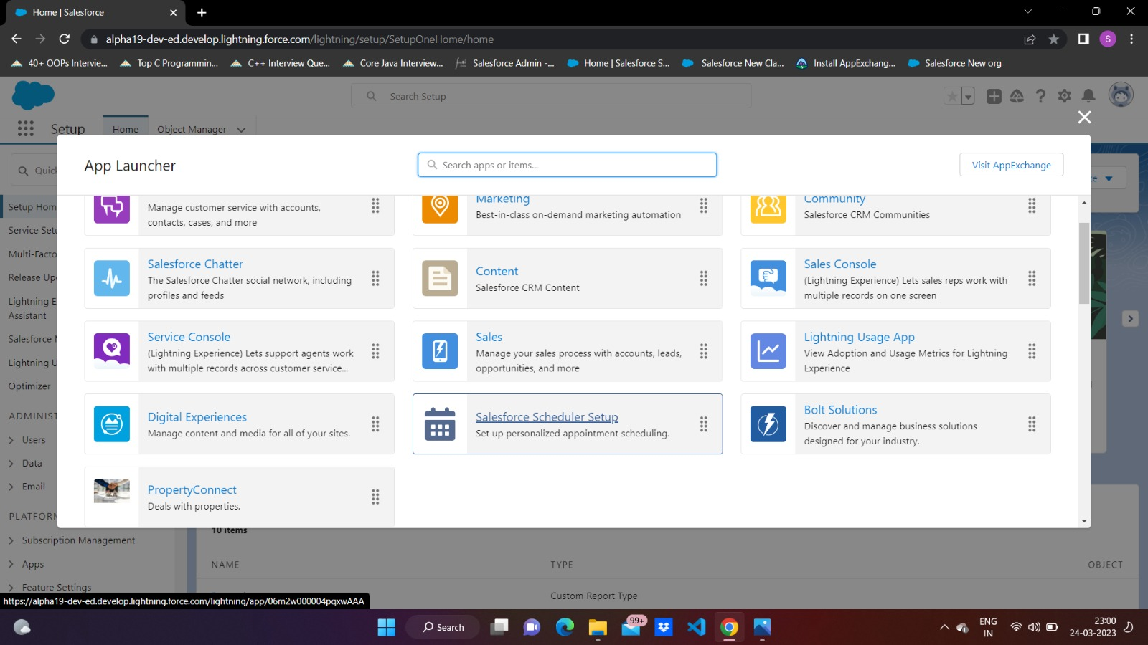

Slide 4
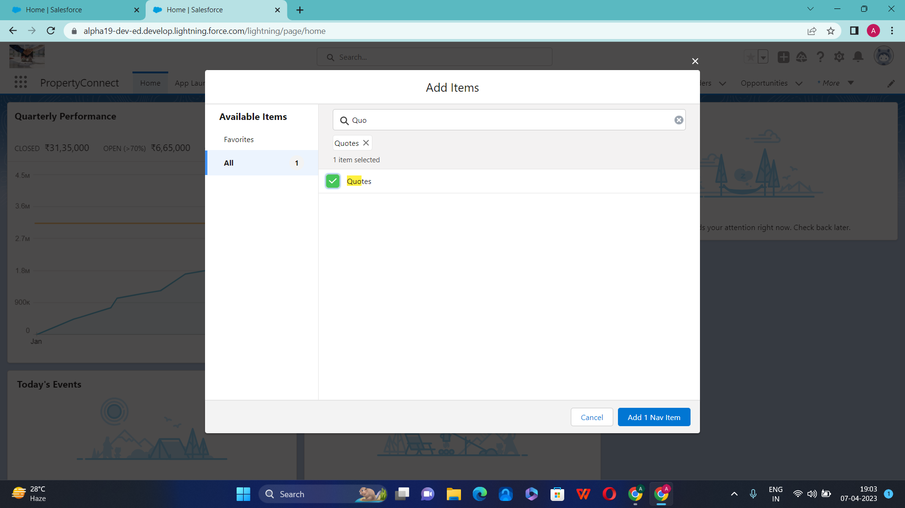

Slide 5
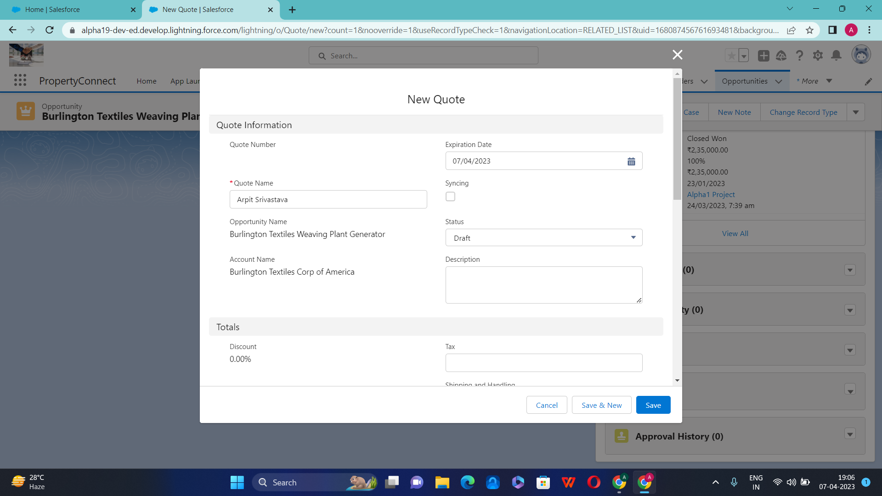

Slide 6
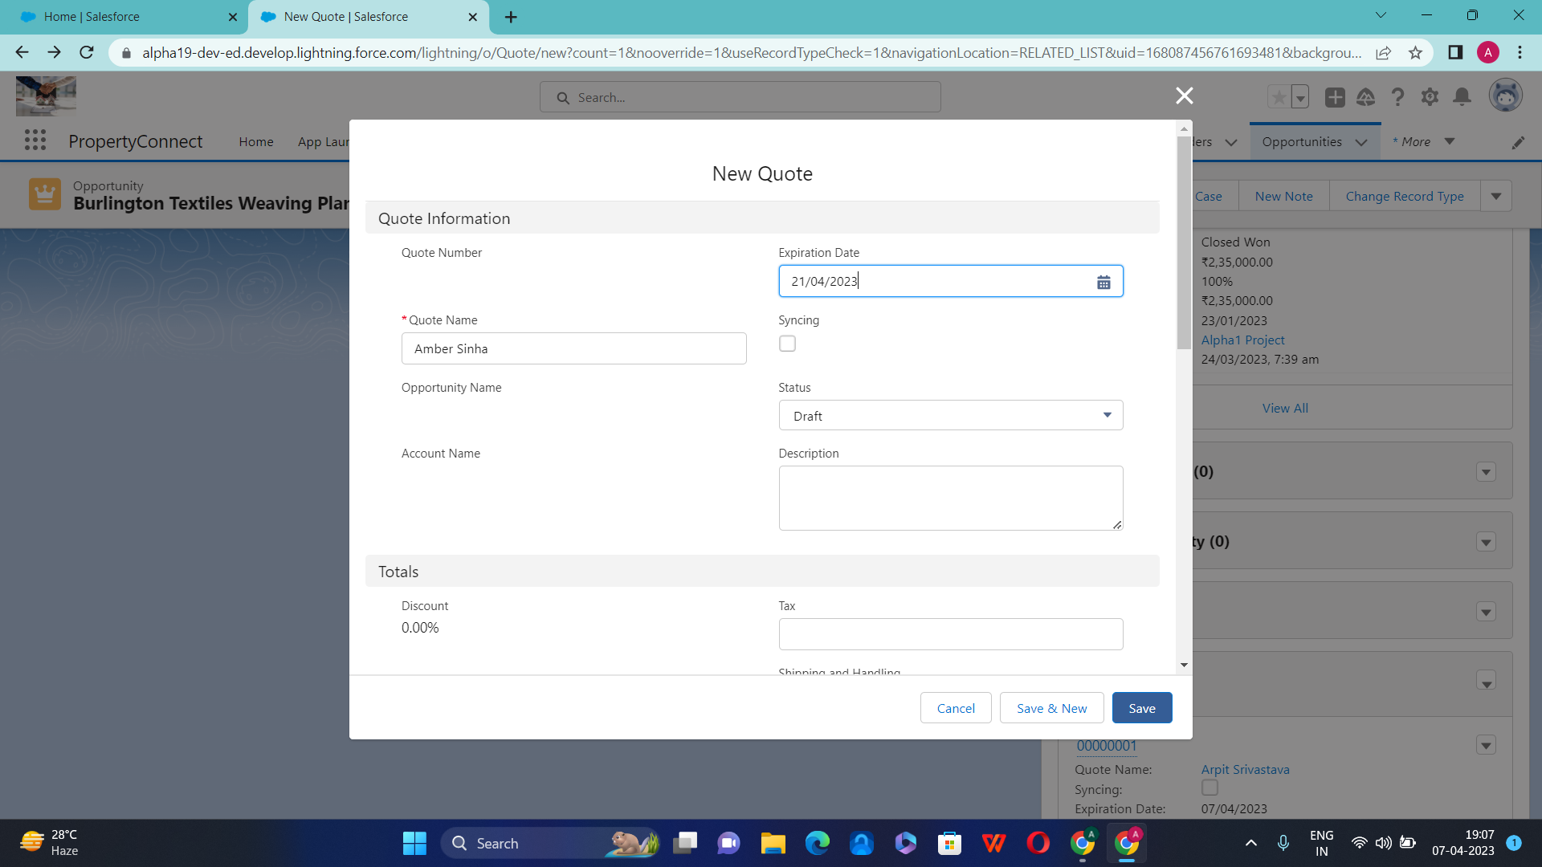

Slide 7
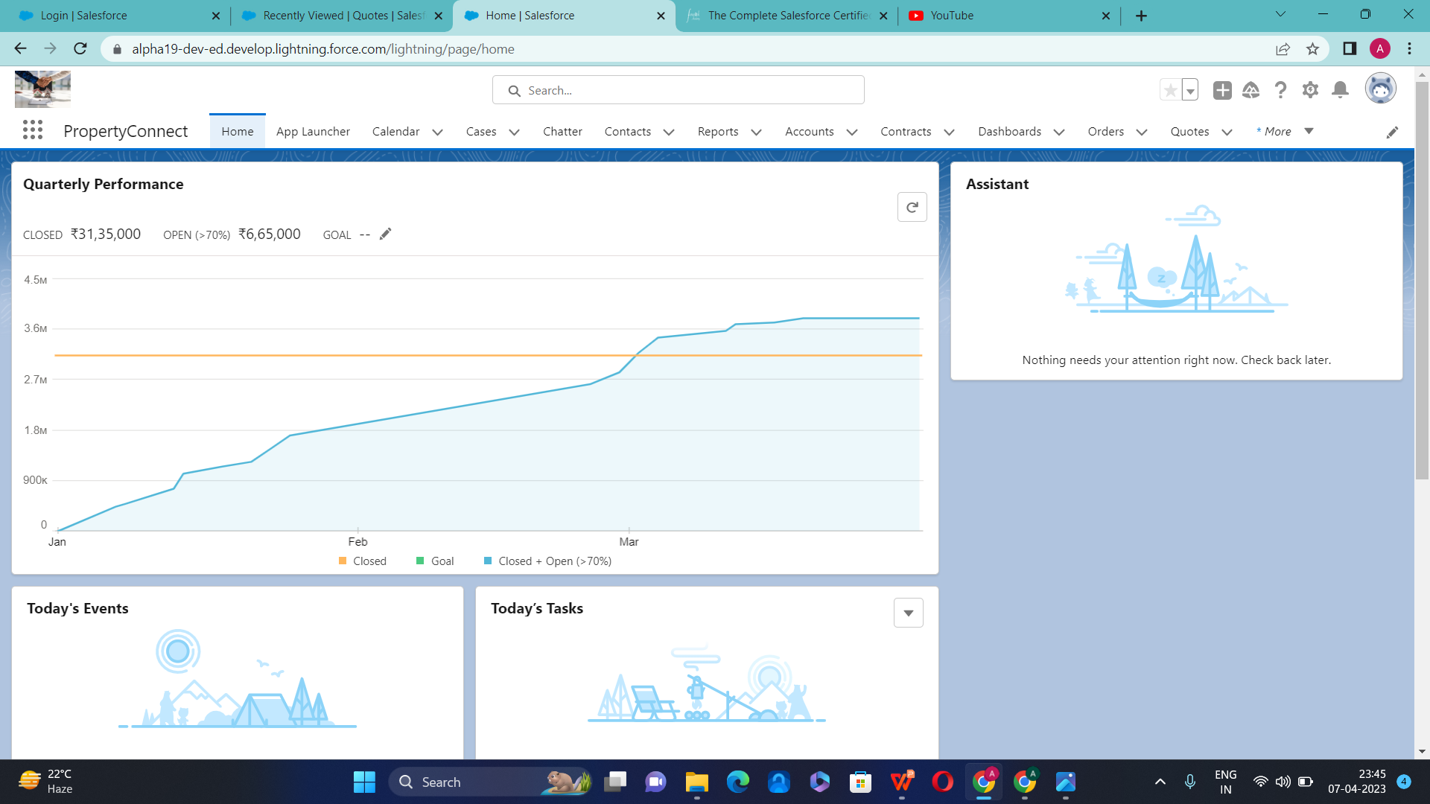

Slide 8
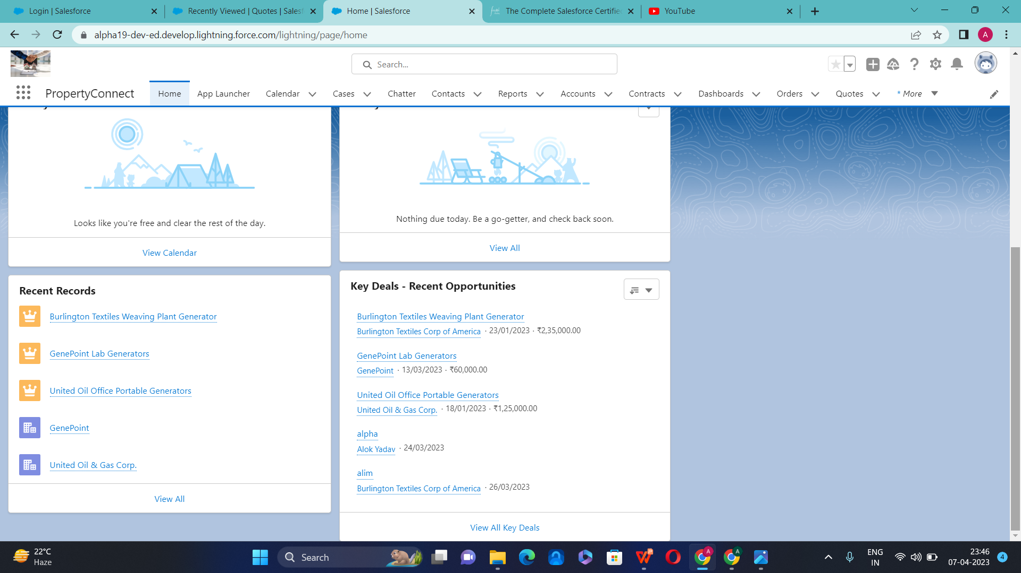

Slide 9
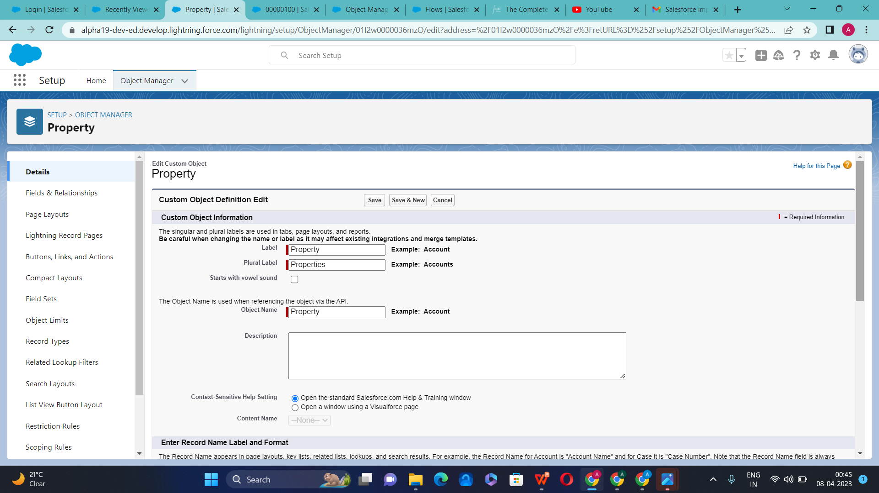
Creation of Property Custom Object

Slide 10
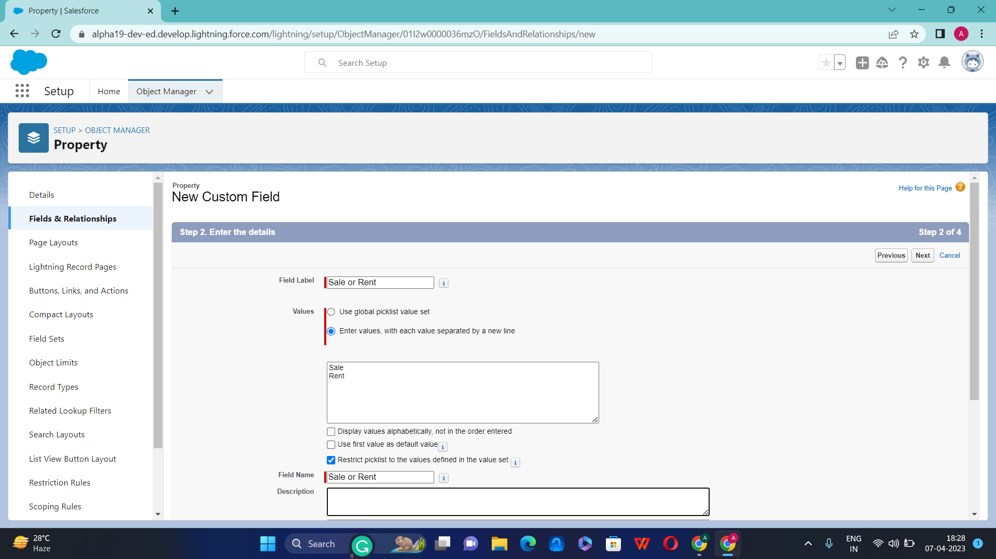

Slide 11
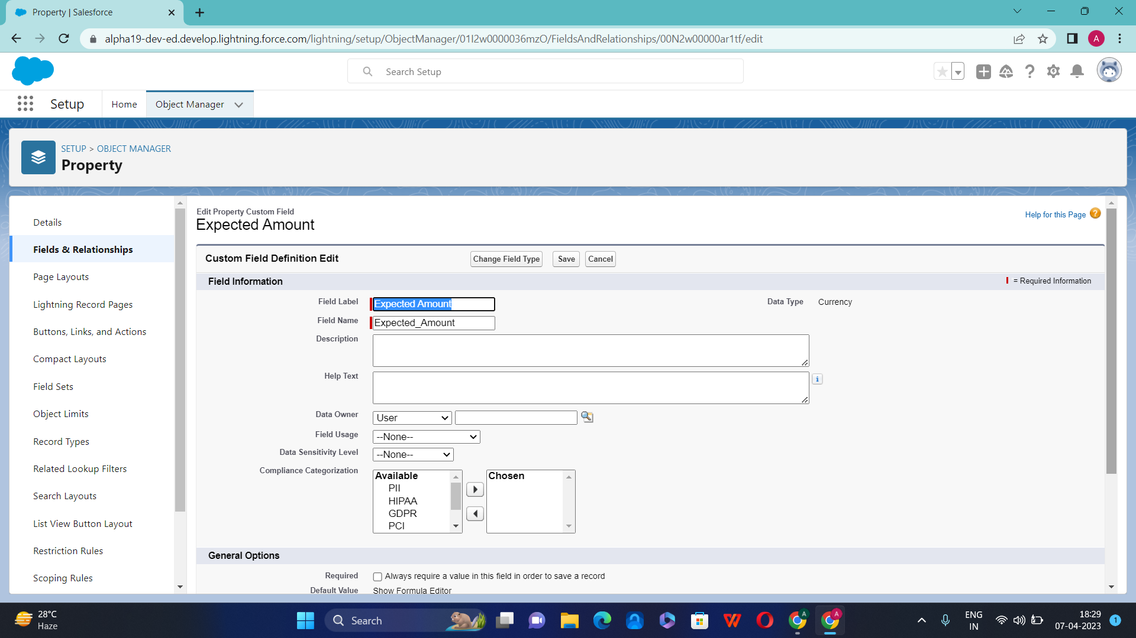

Slide 12
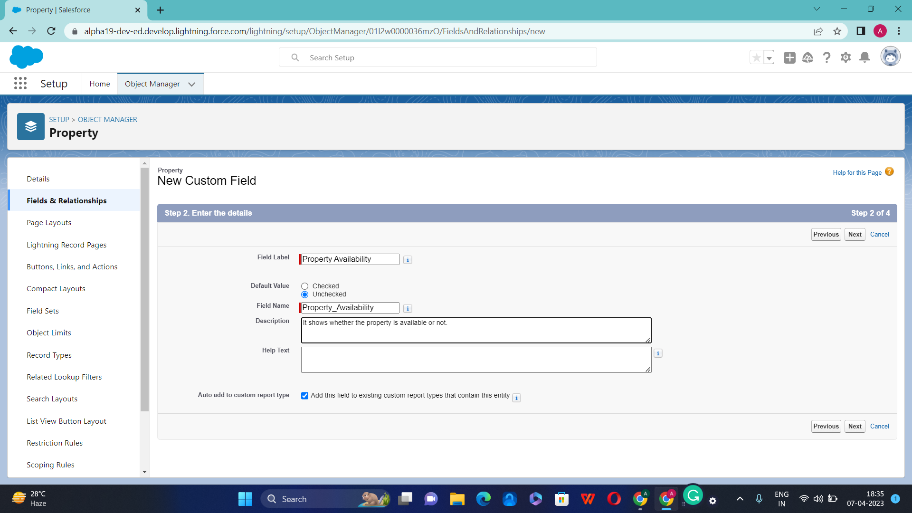

Slide 13
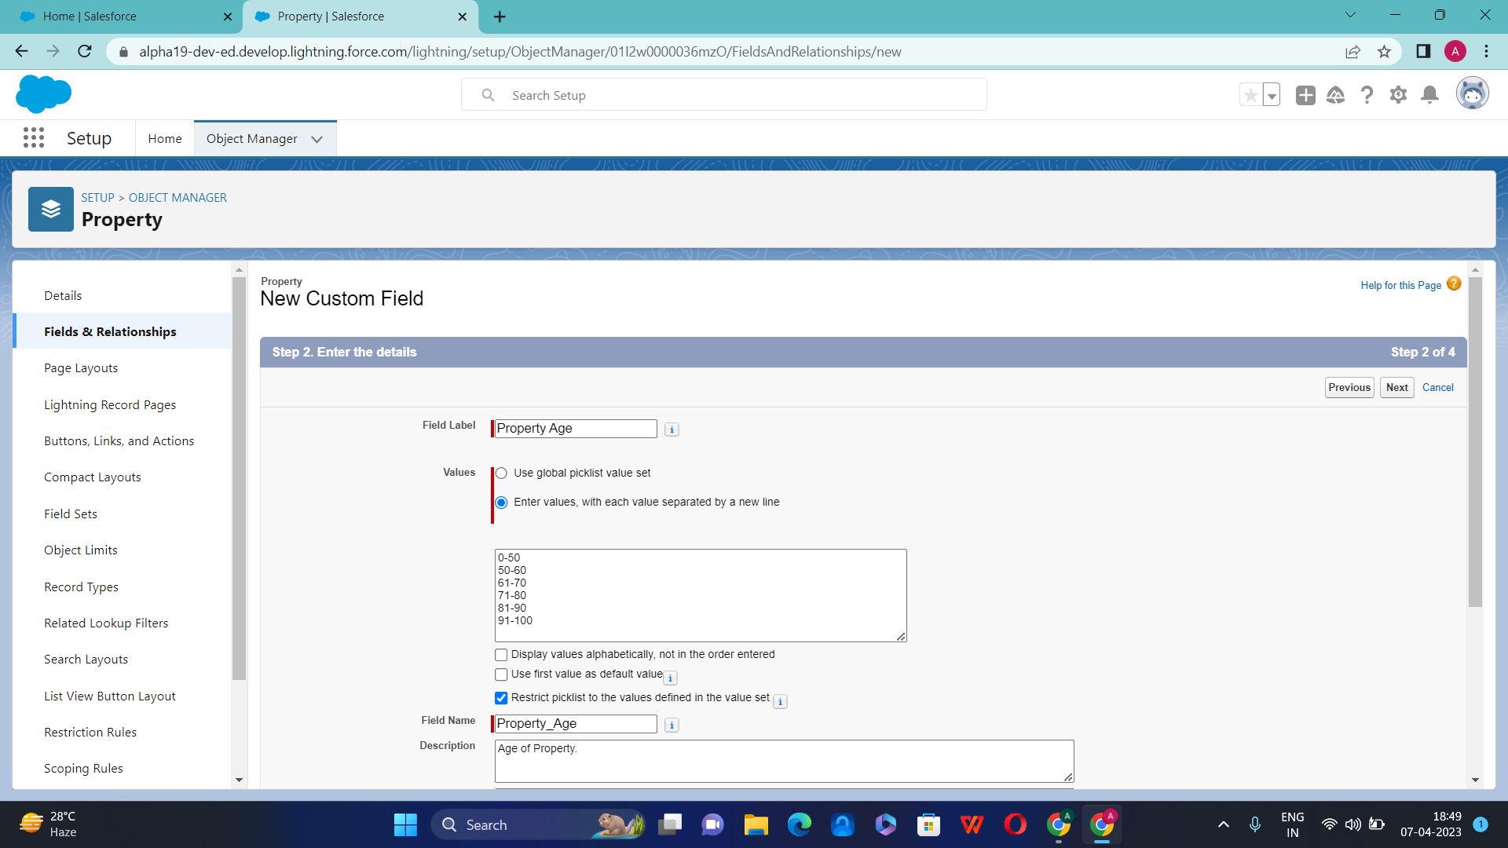

Slide 14
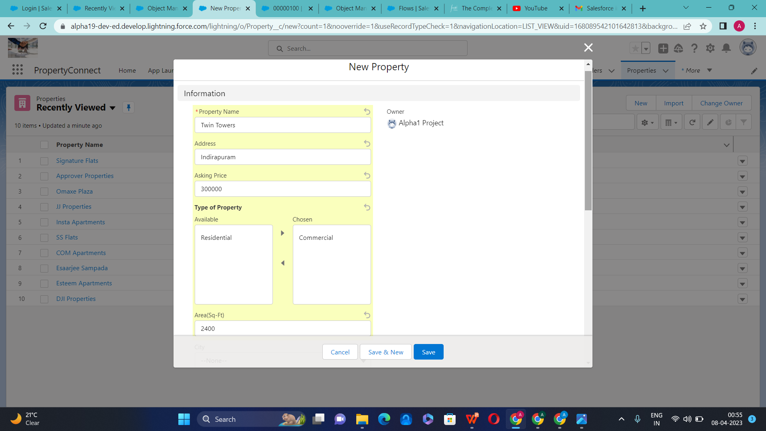
Add New Property

Slide 15
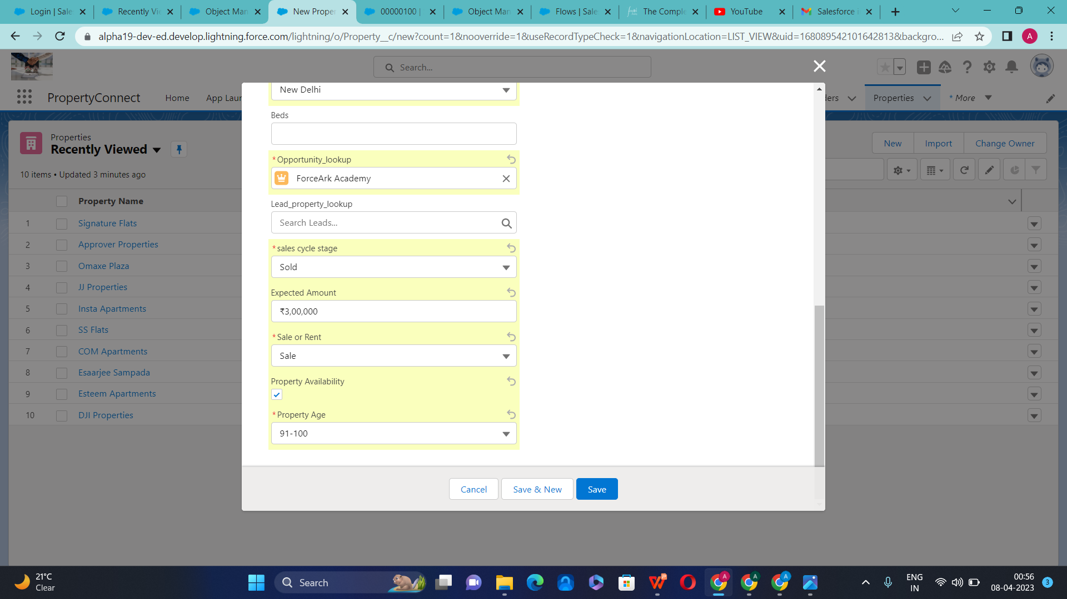

Slide 16
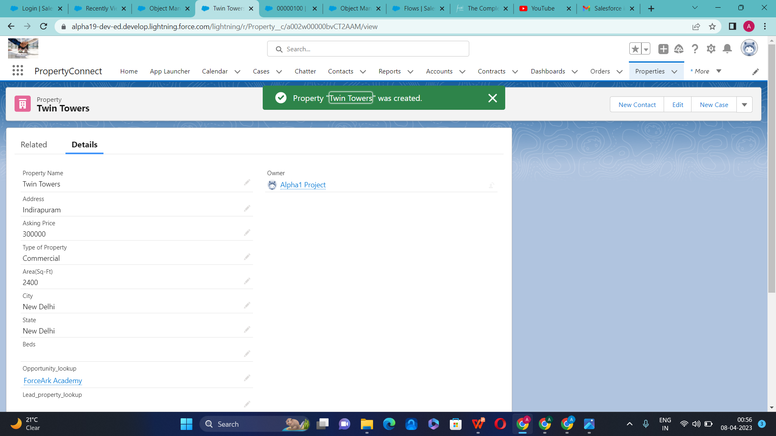

Slide 17
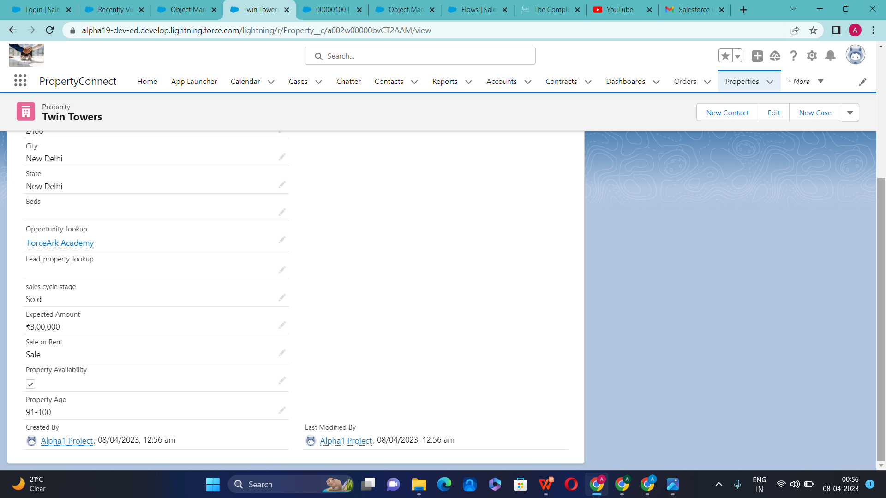

Slide 18
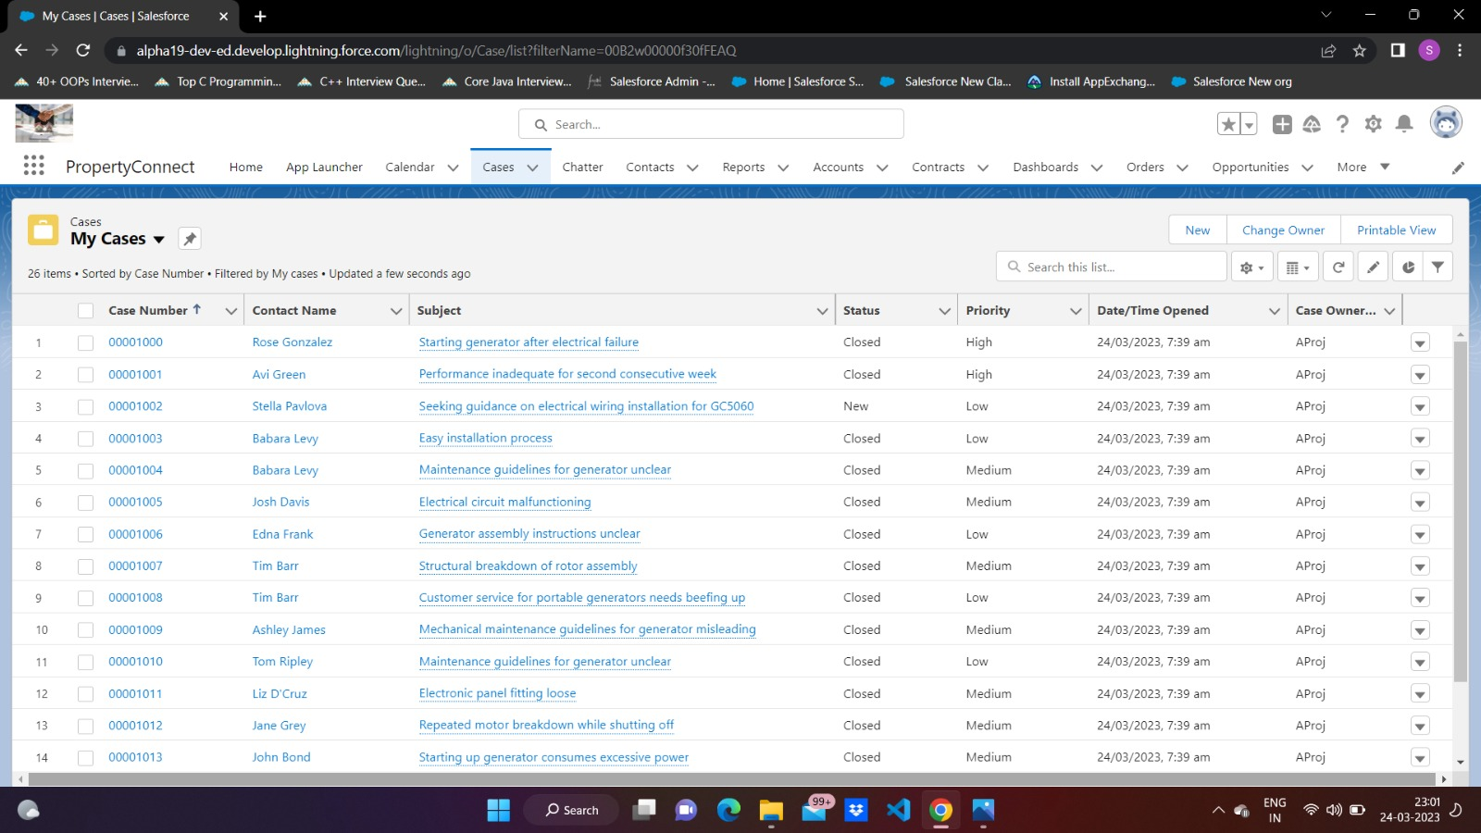

Slide 19
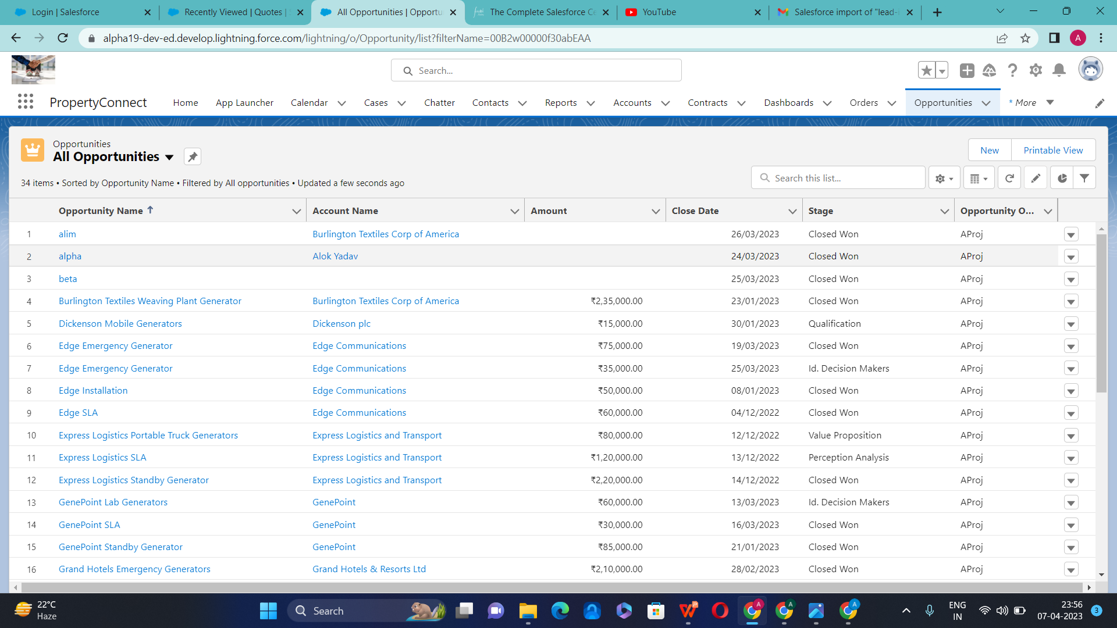

Slide 20
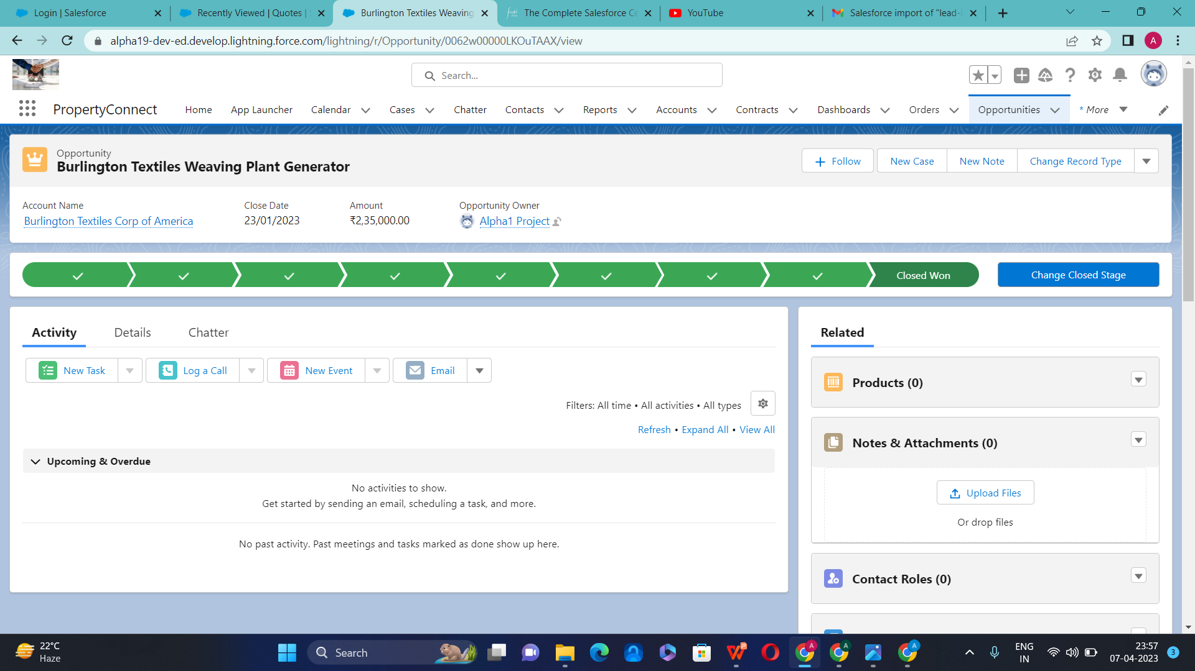

Slide 21
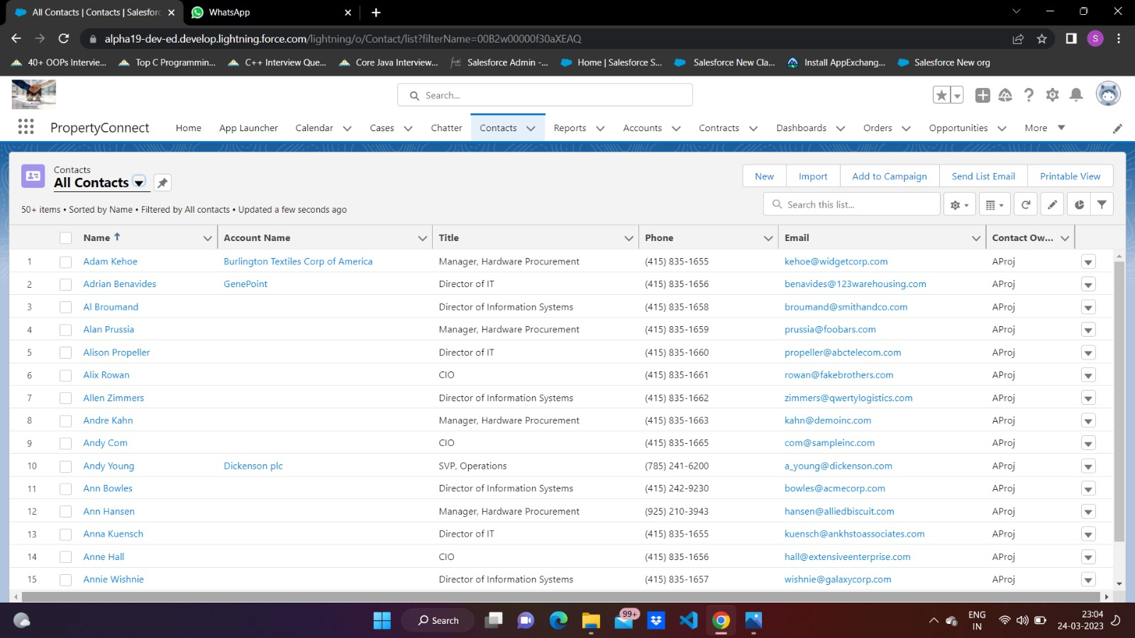

Slide 22
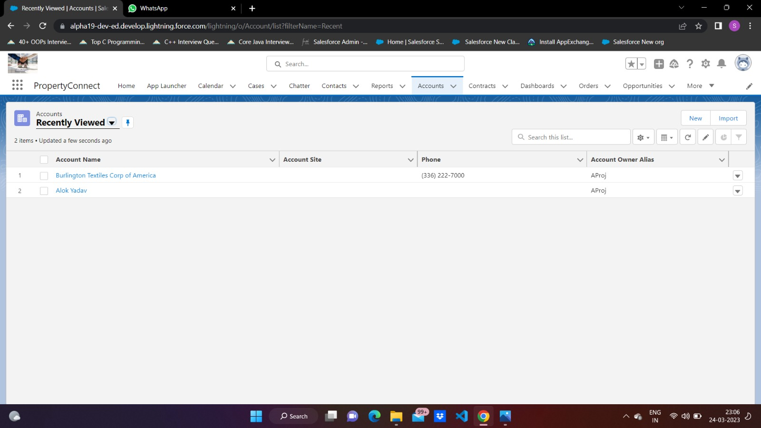

Slide 23
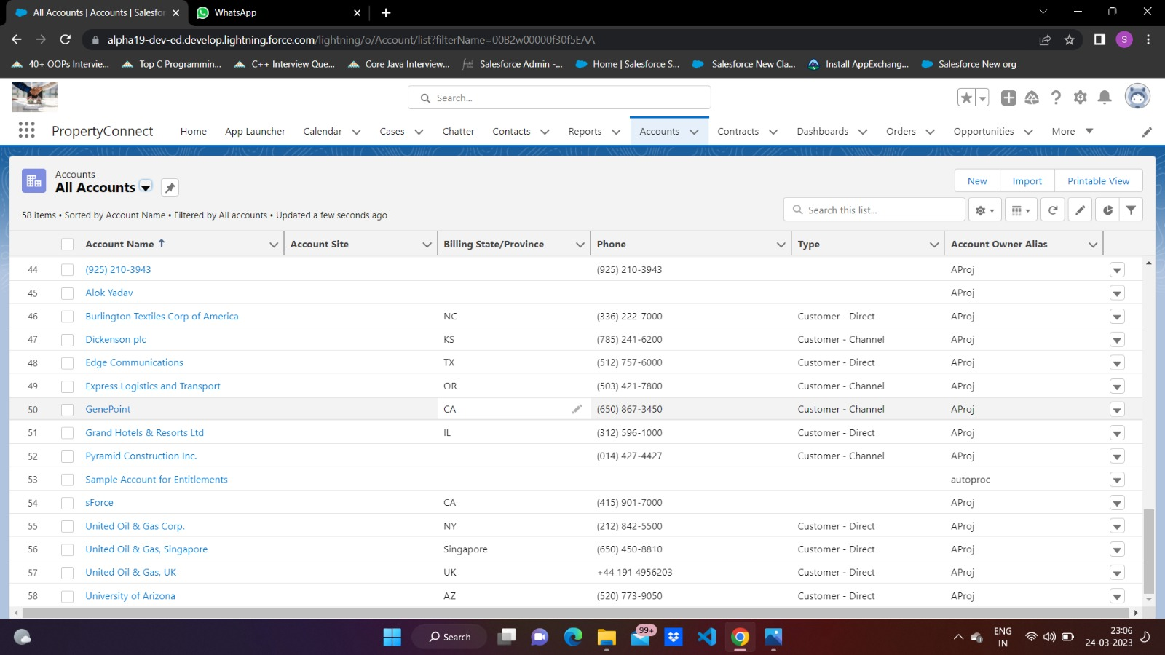

Slide 24
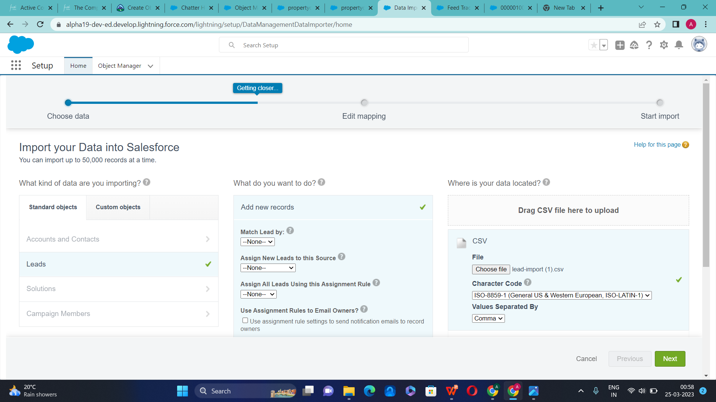

Slide 25
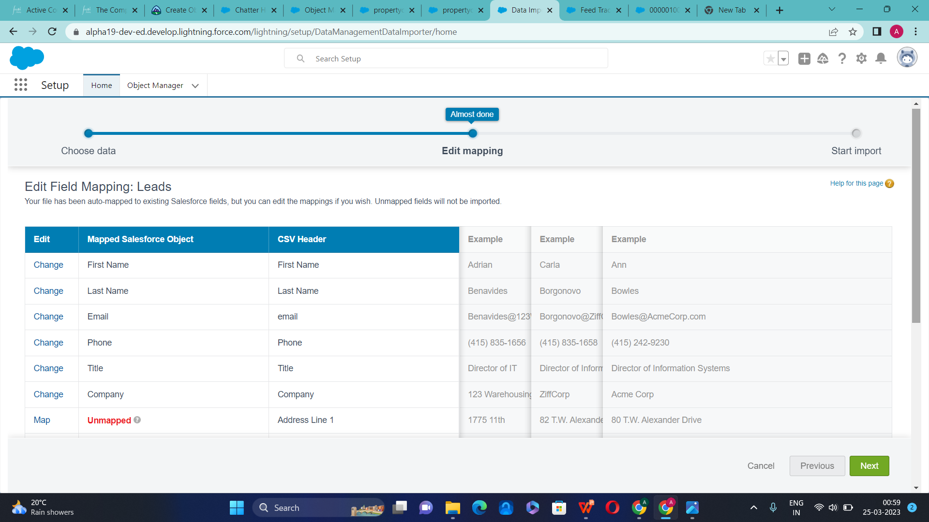

Slide 26
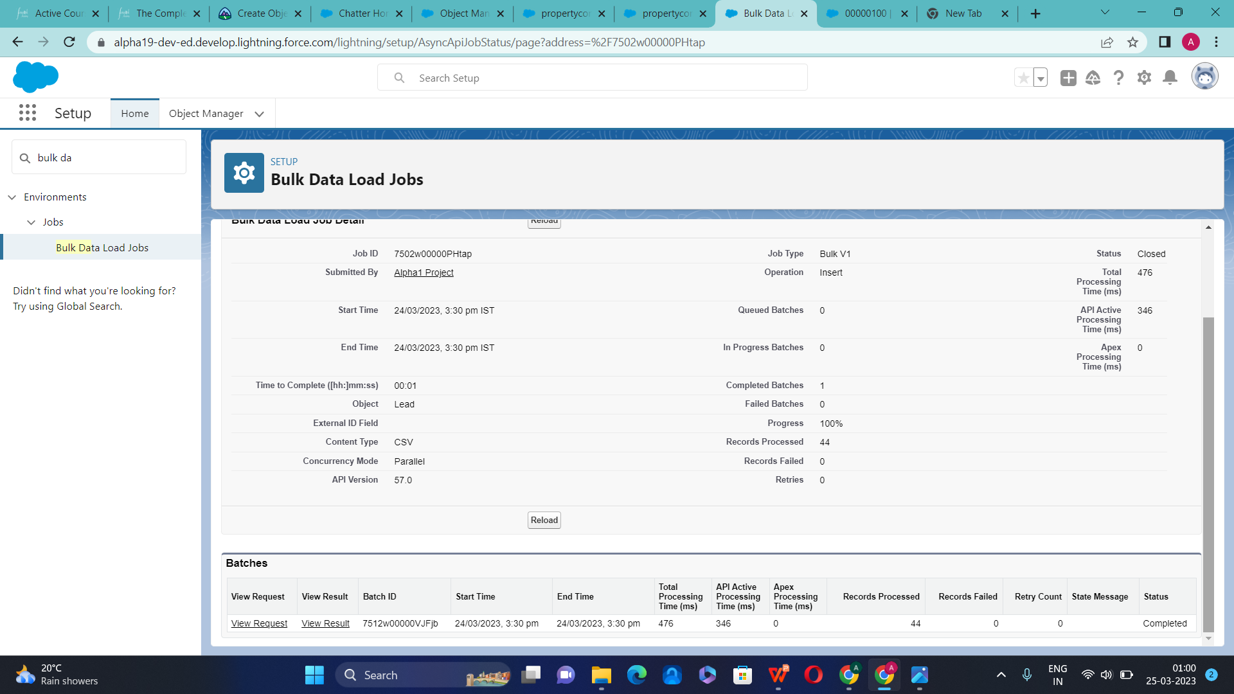

Slide 27
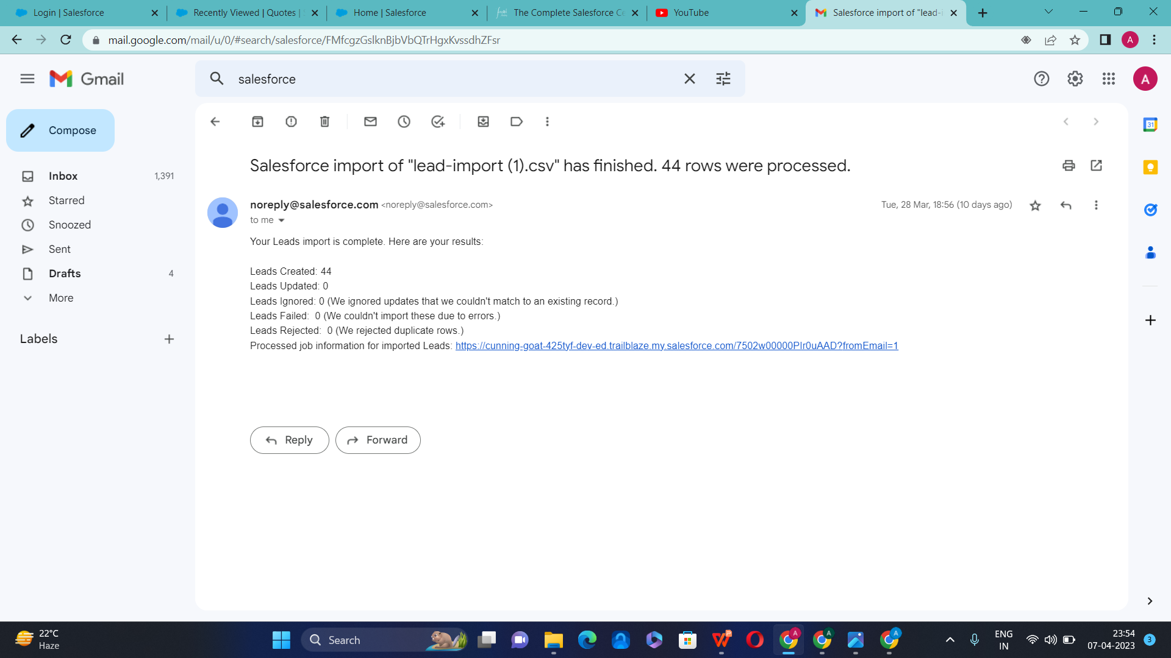

Slide 28
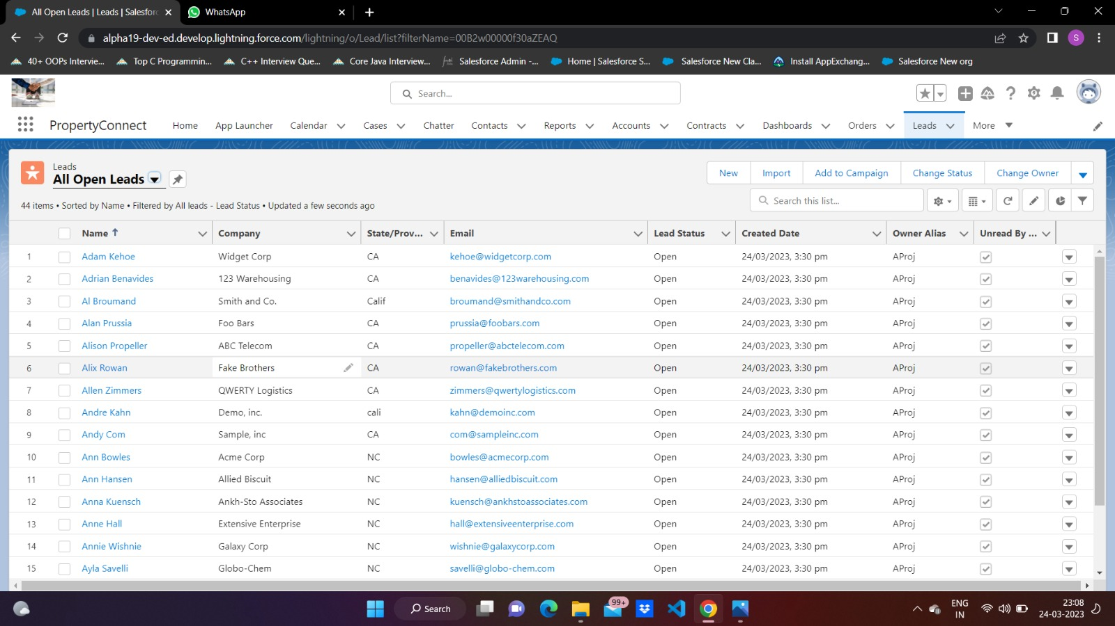

Slide 29
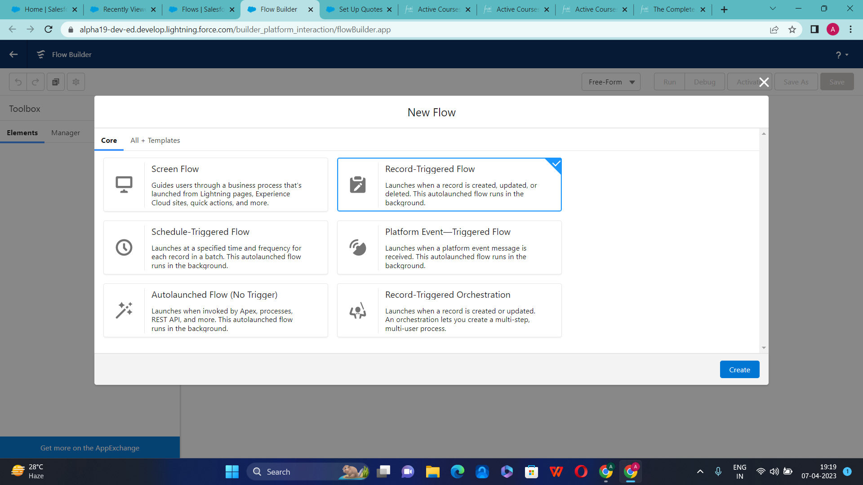

Slide 30
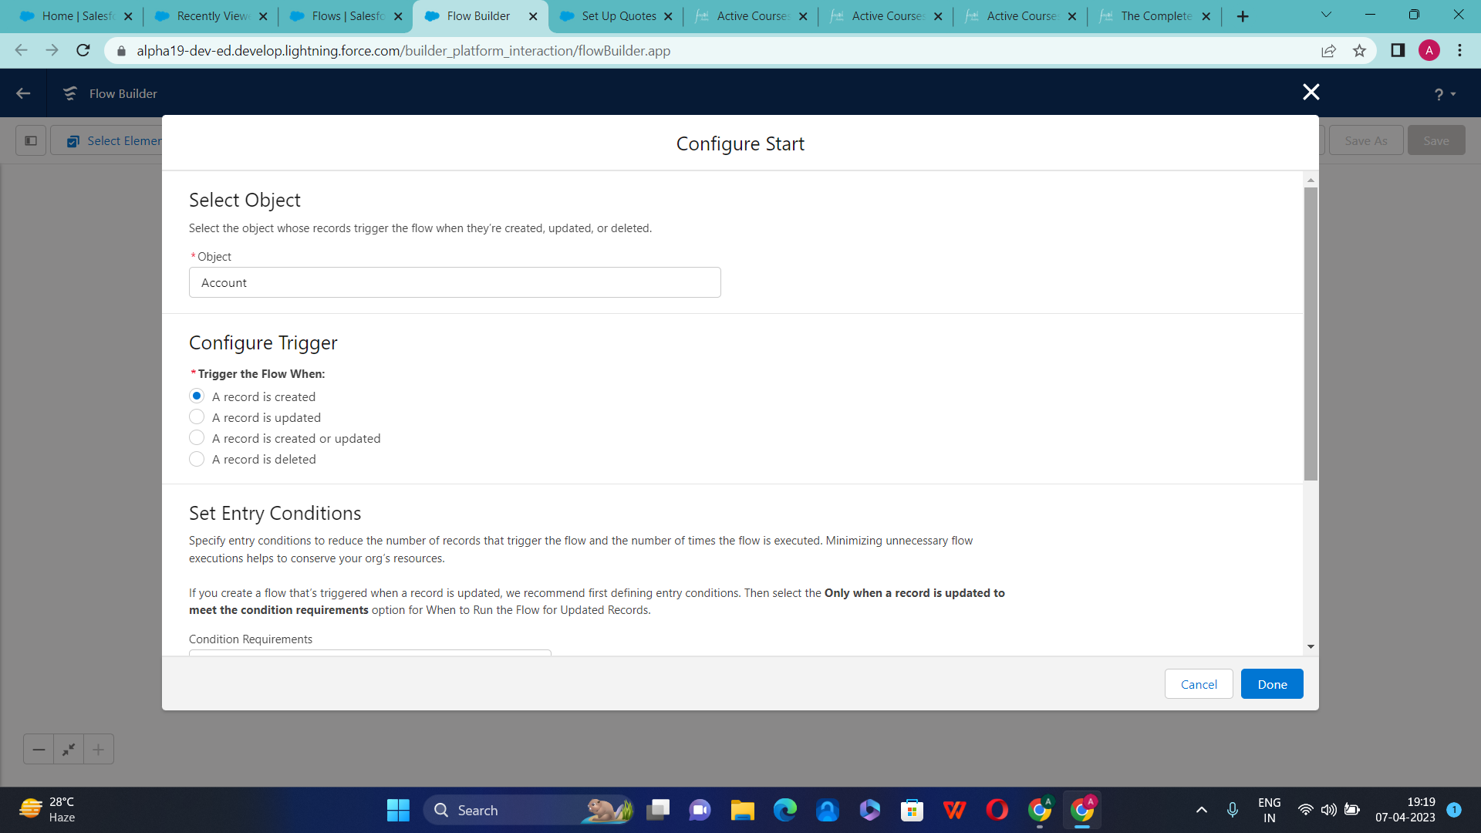

Slide 31
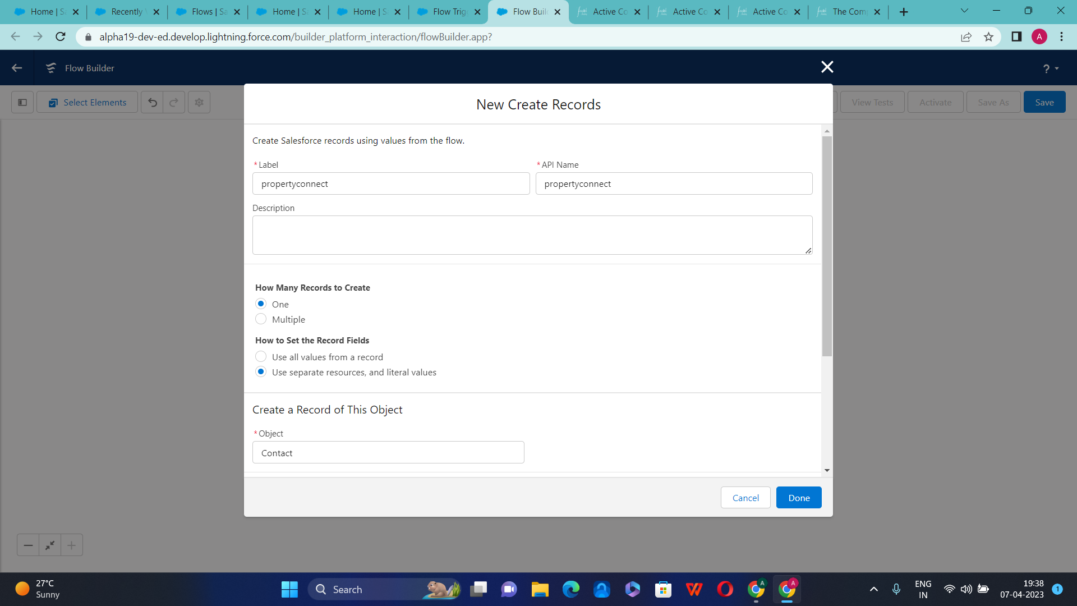

Slide 32
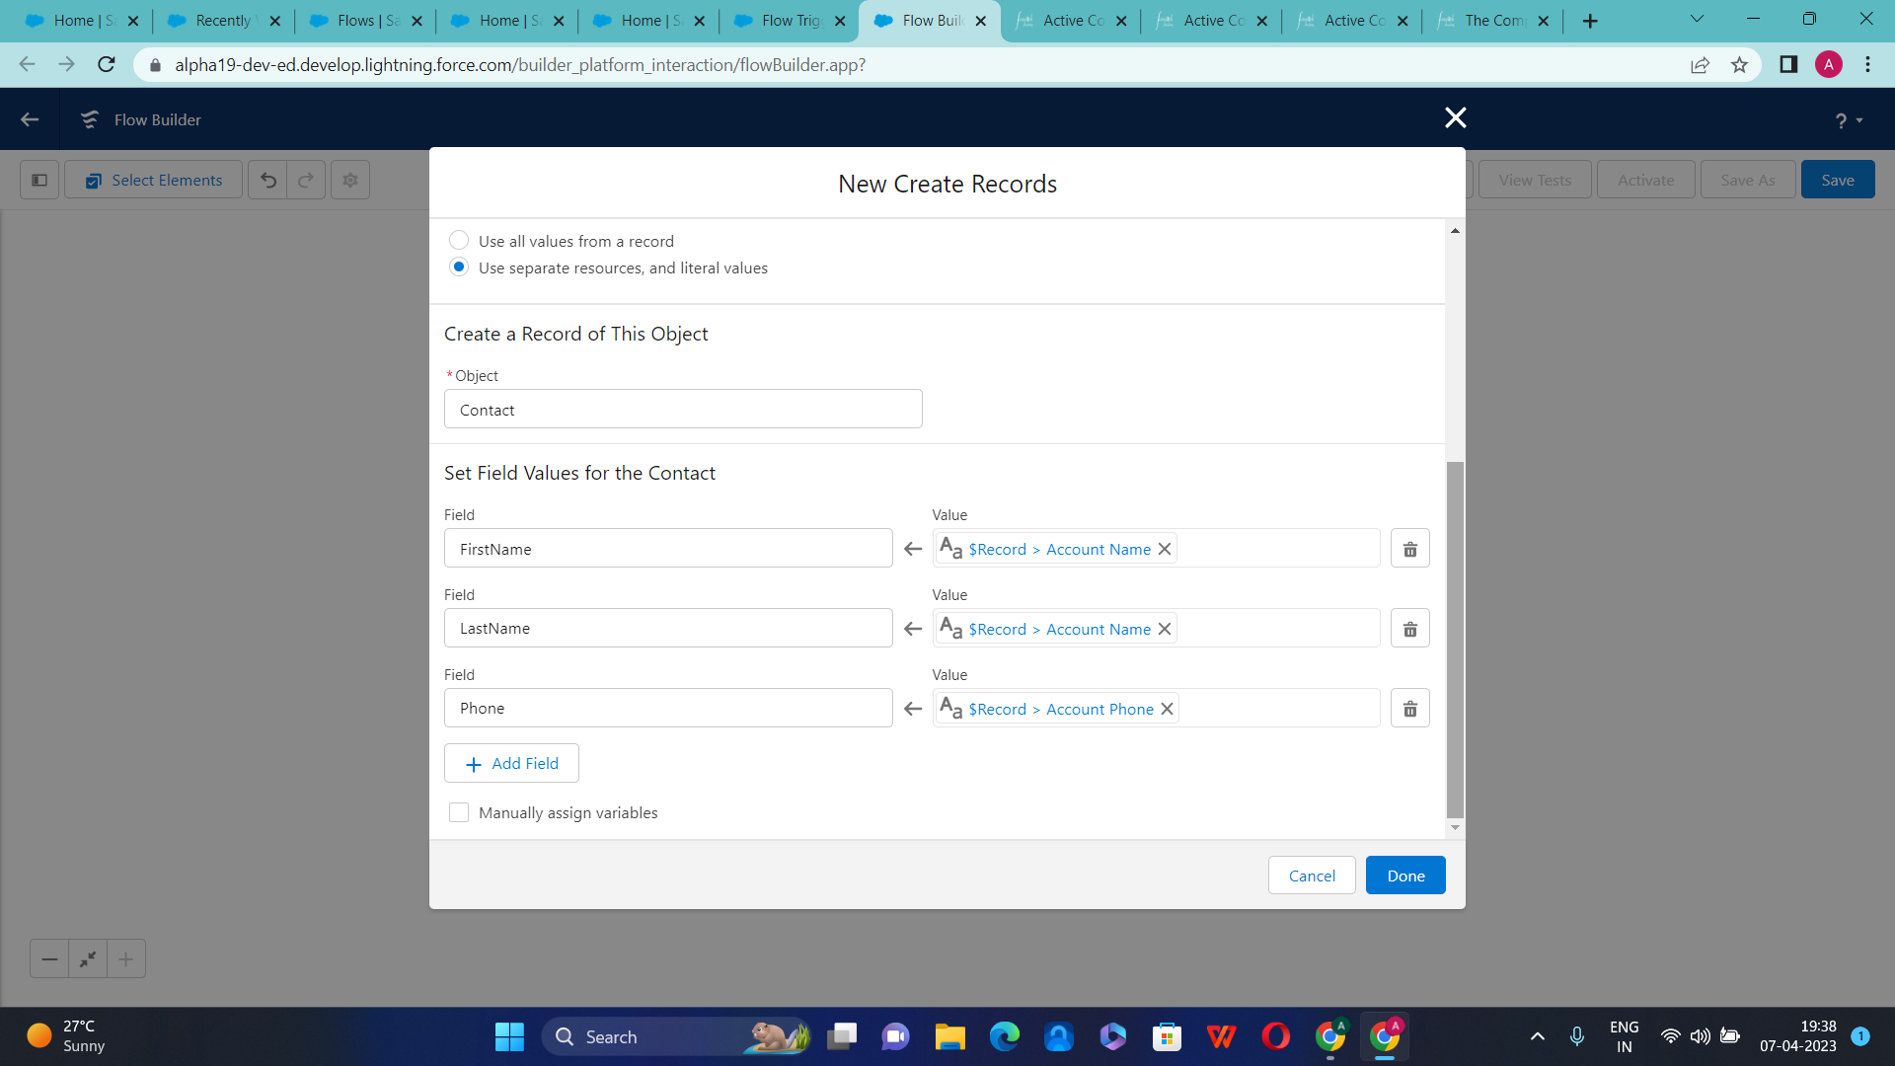

Slide 33
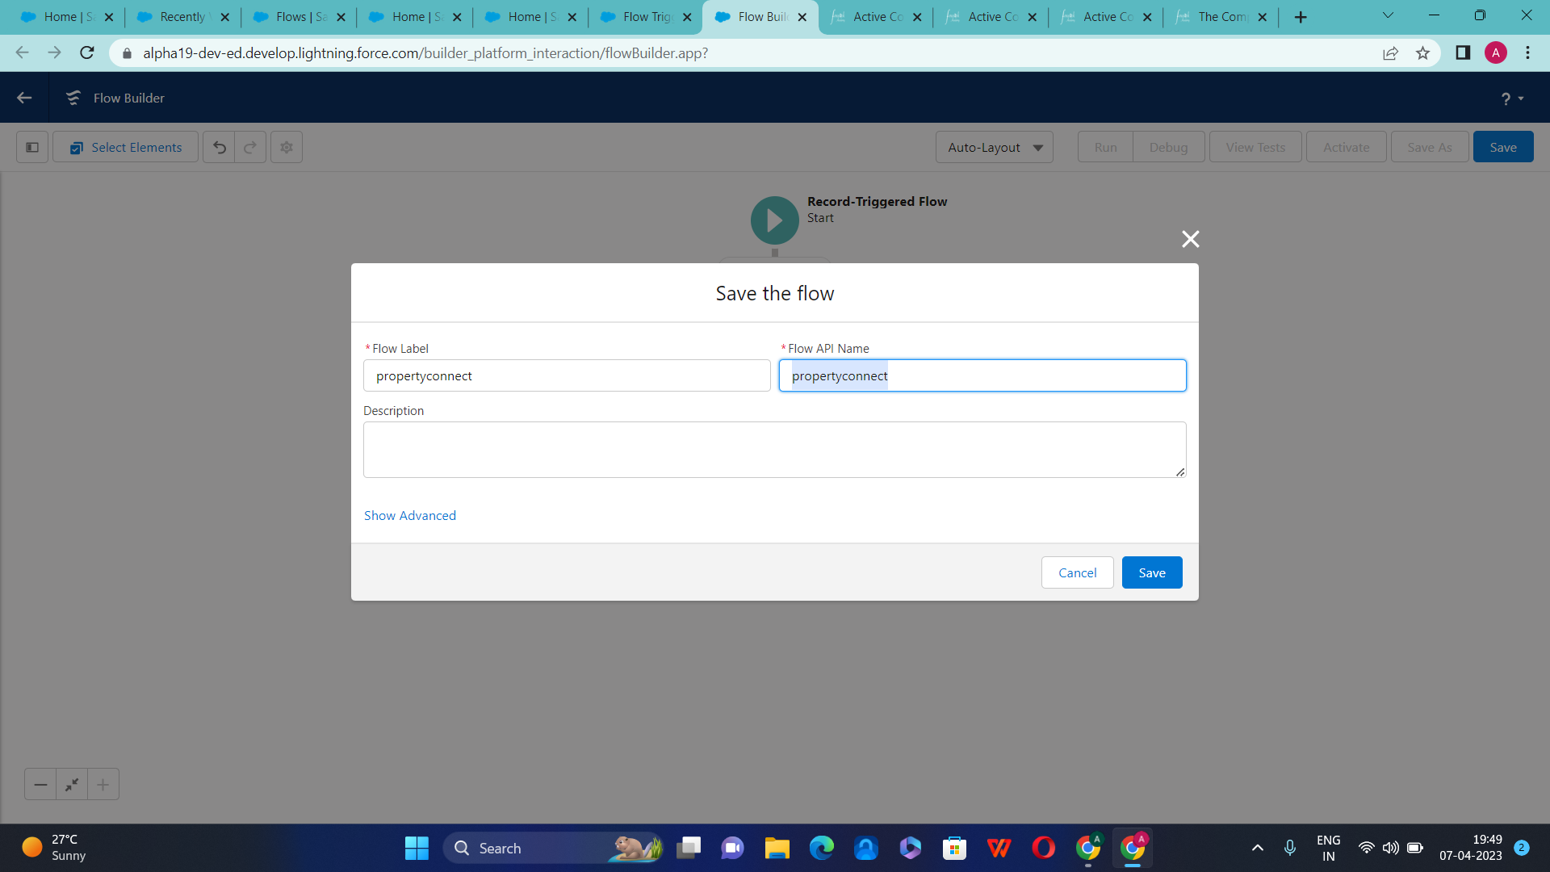

Slide 34
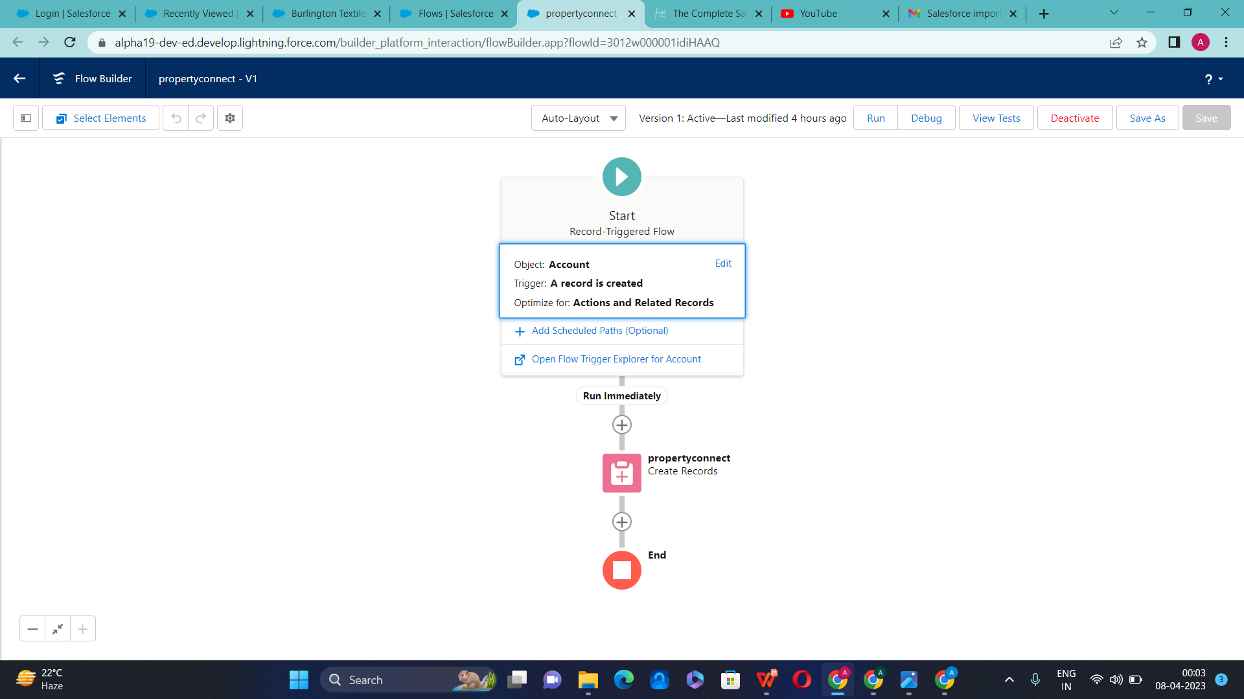

Slide 35
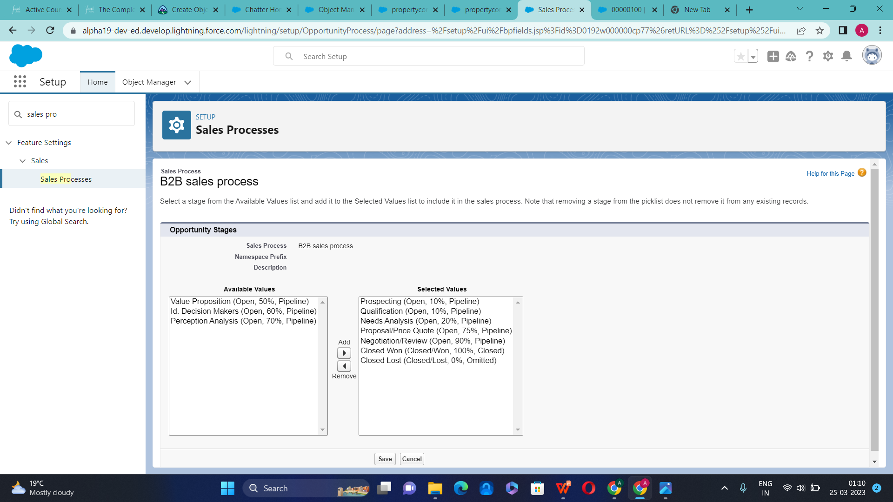

Slide 36
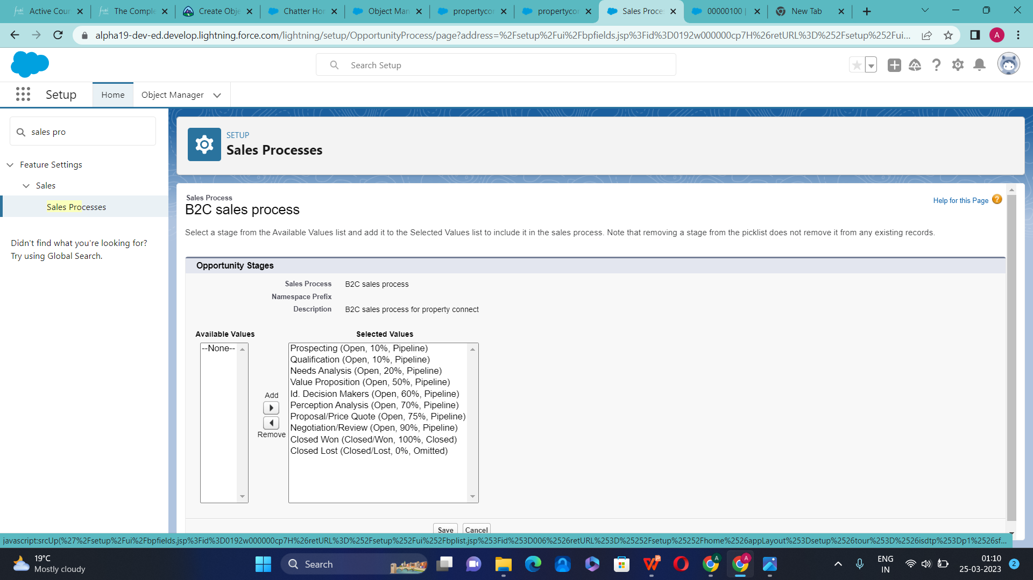

Slide 37
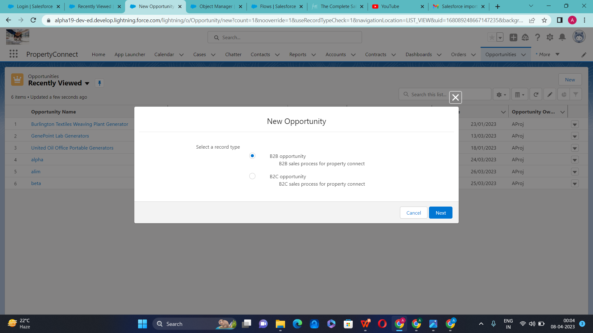

Slide 38
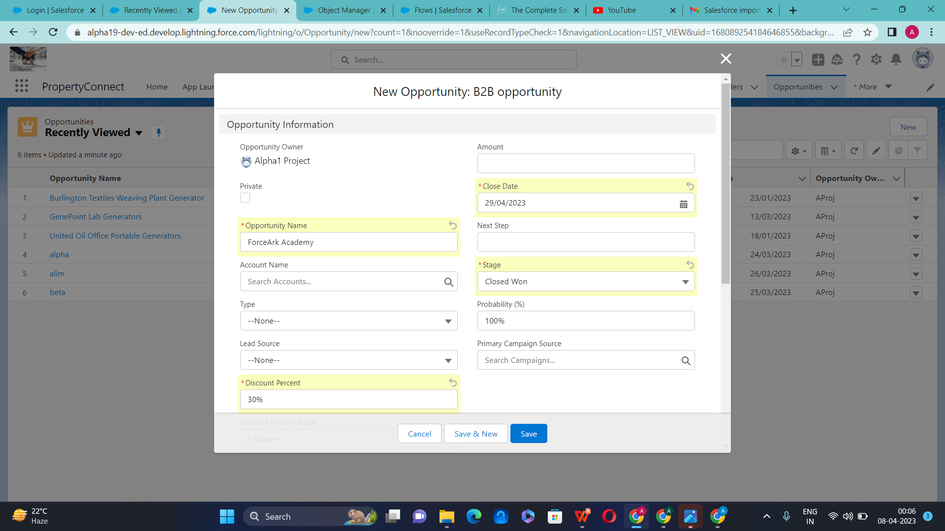

Slide 39
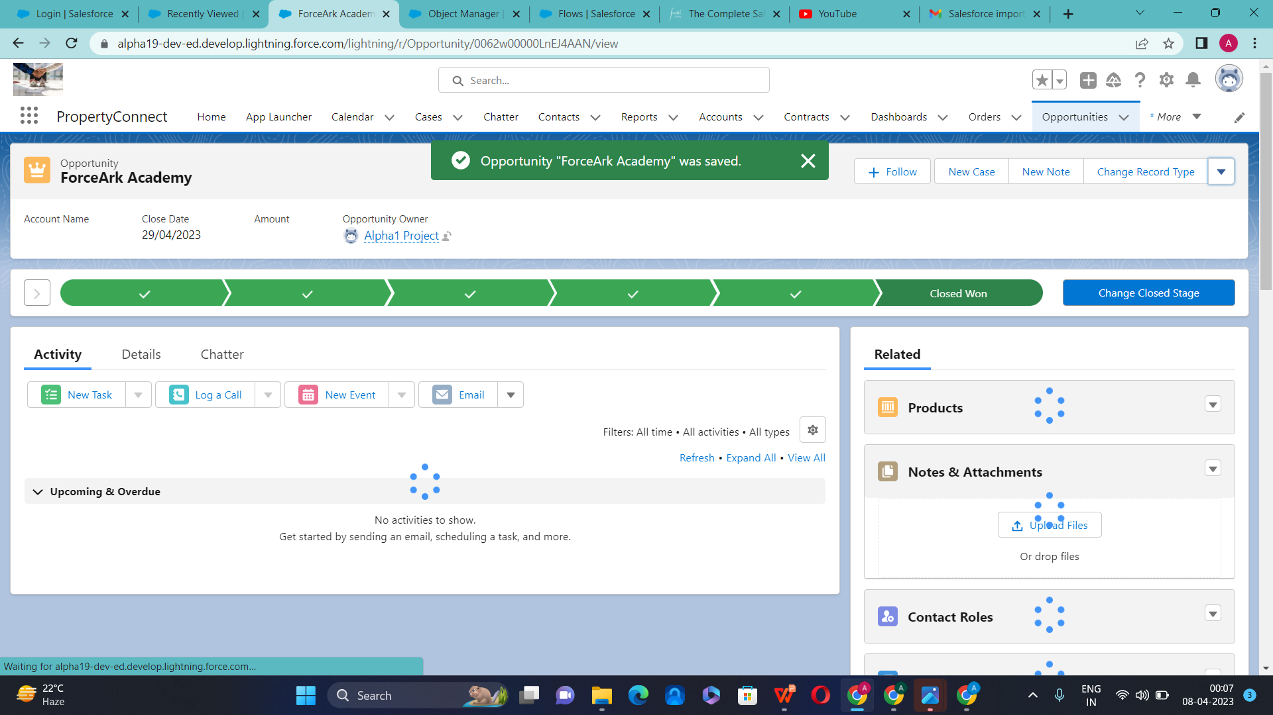

Slide 40
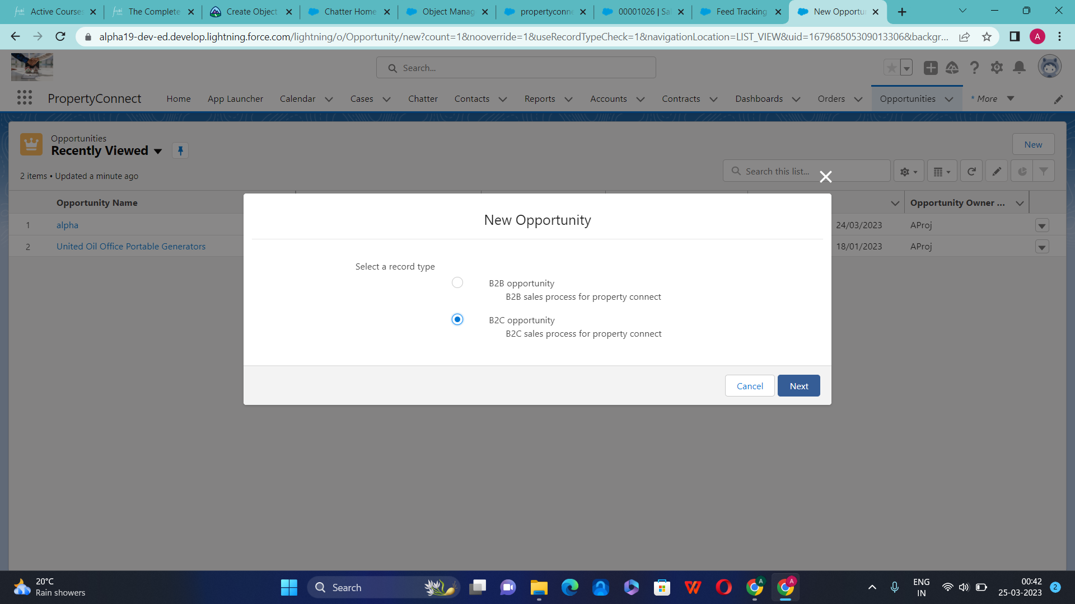

Slide 41
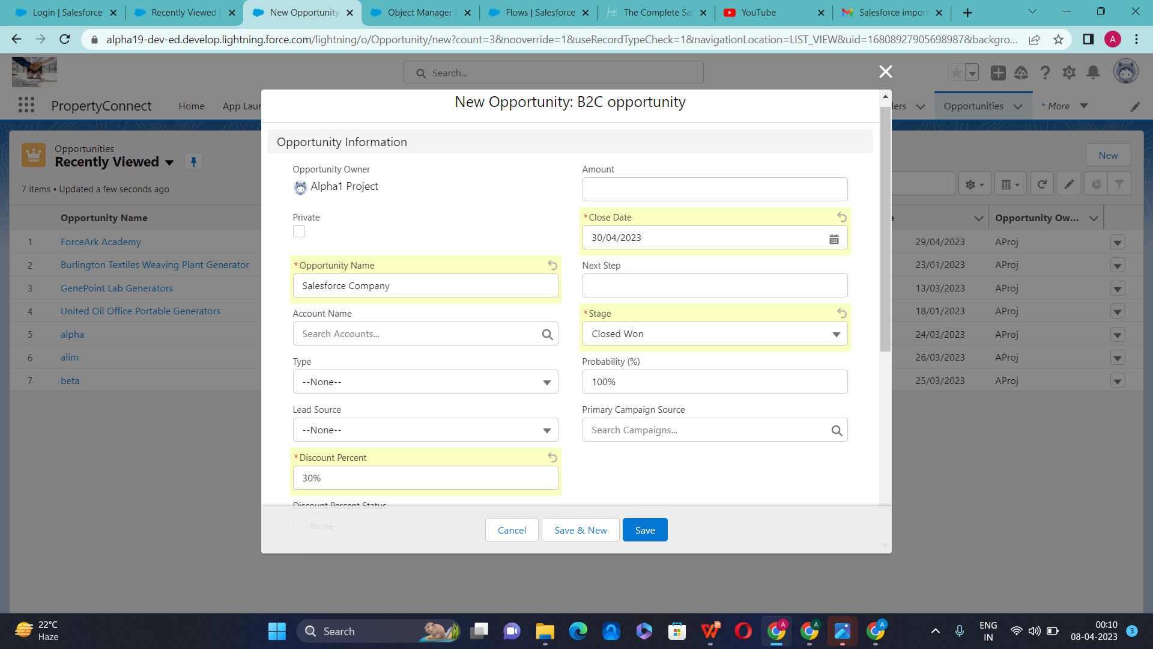

Slide 42
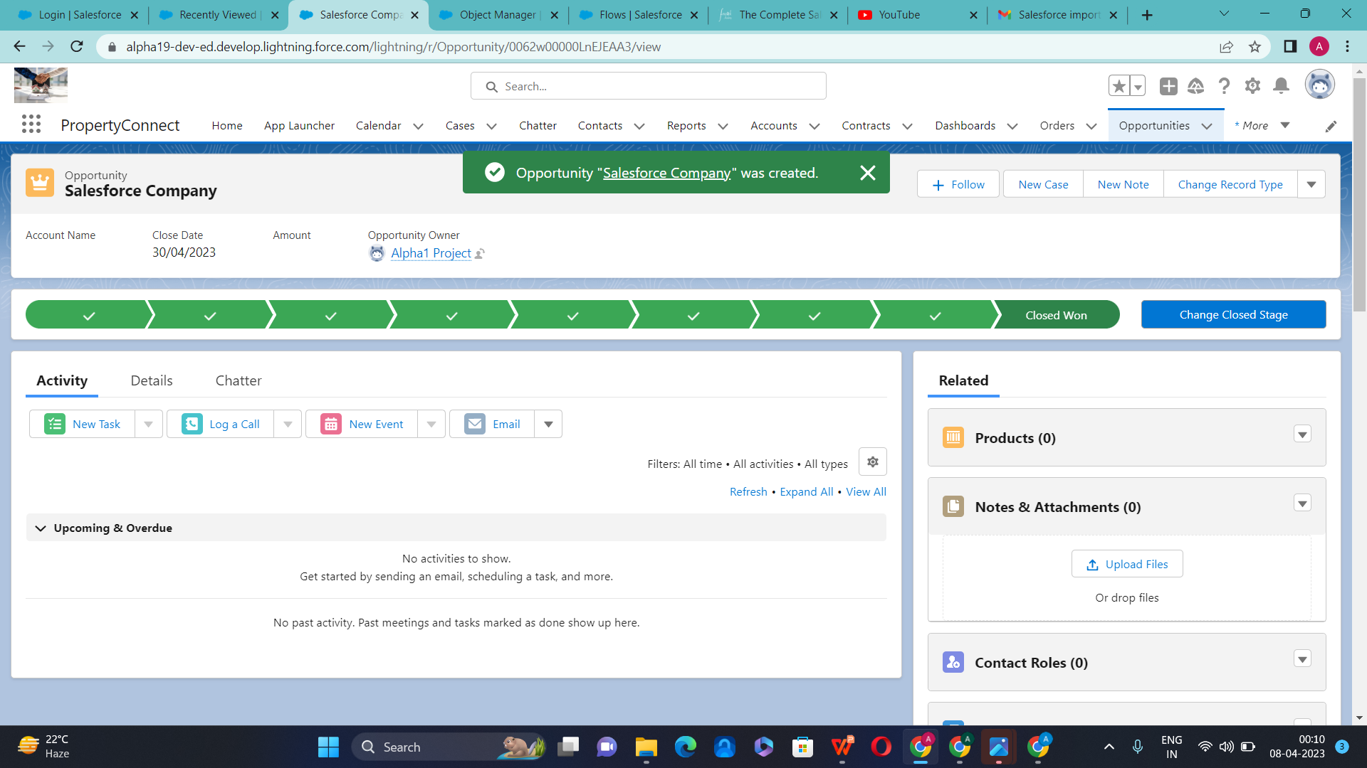

Slide 43
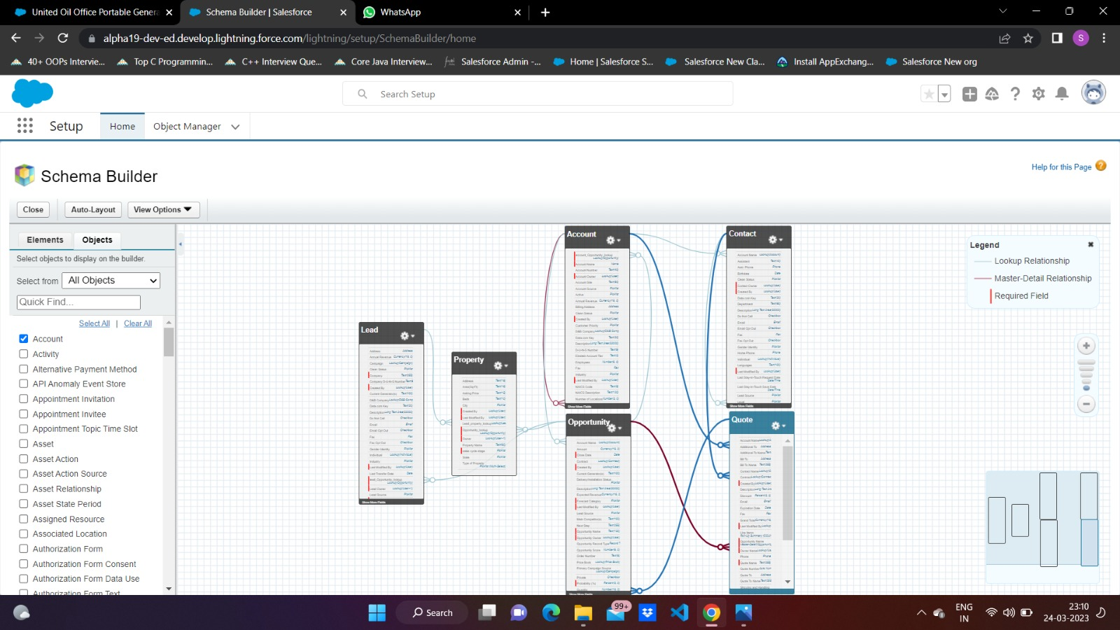
Data Model of Property Management App
Property Connect

Slide 44
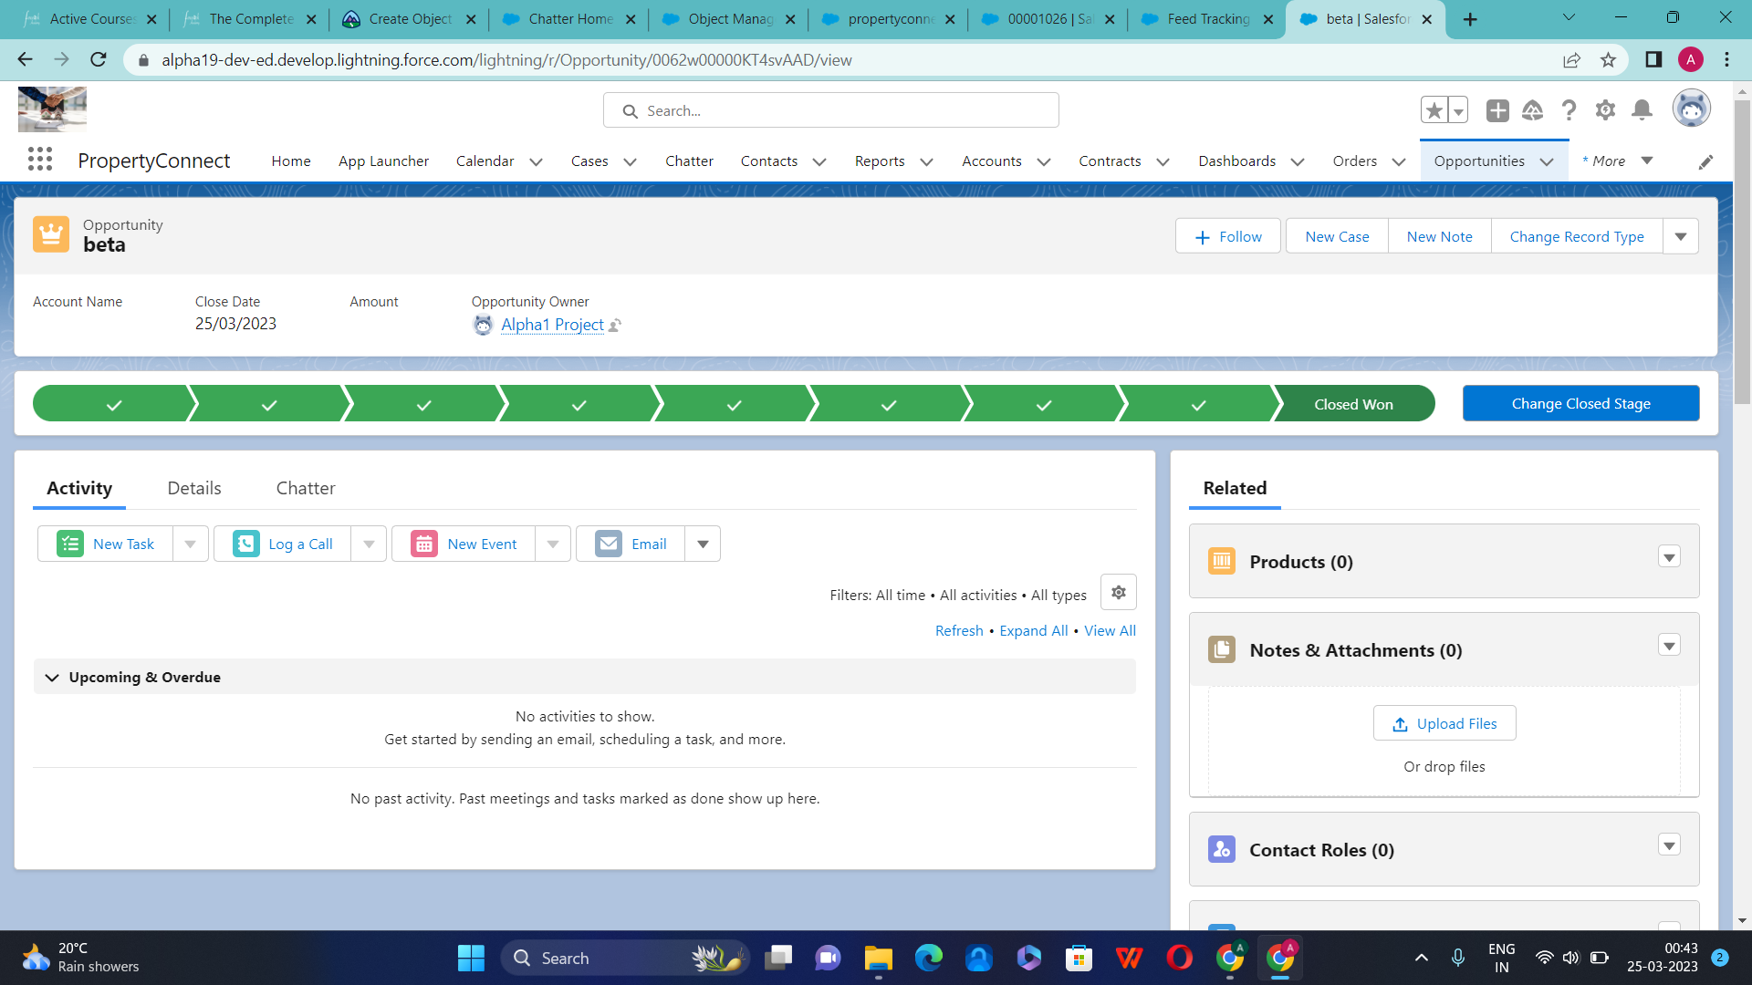

Slide 45
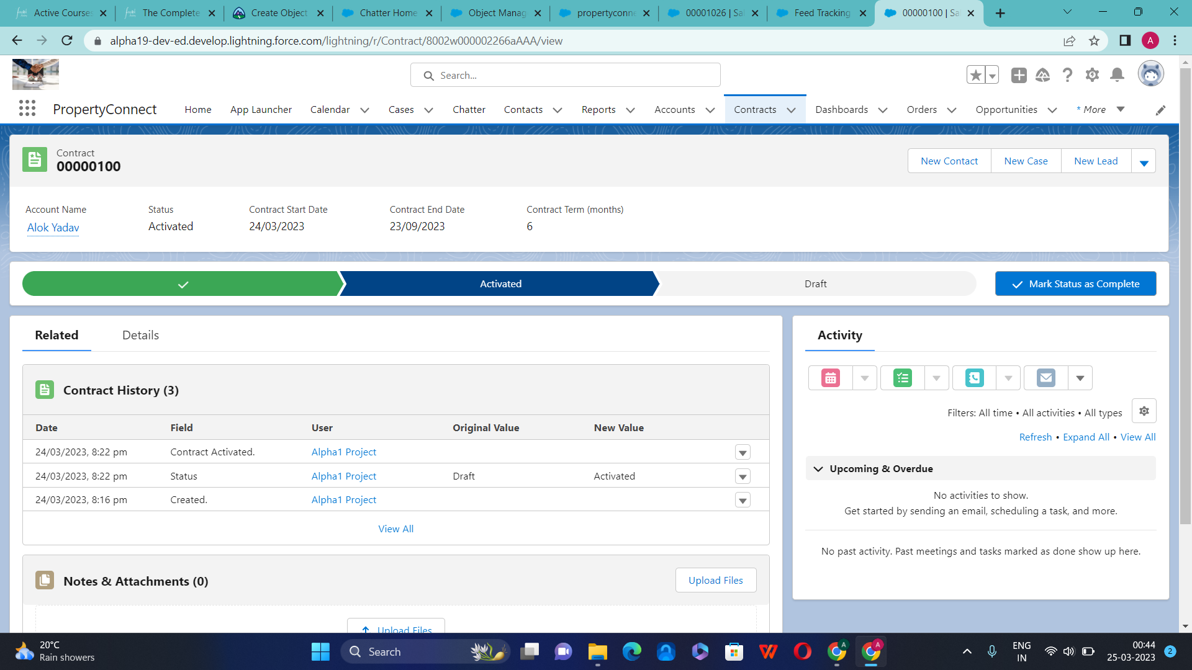

Slide 46
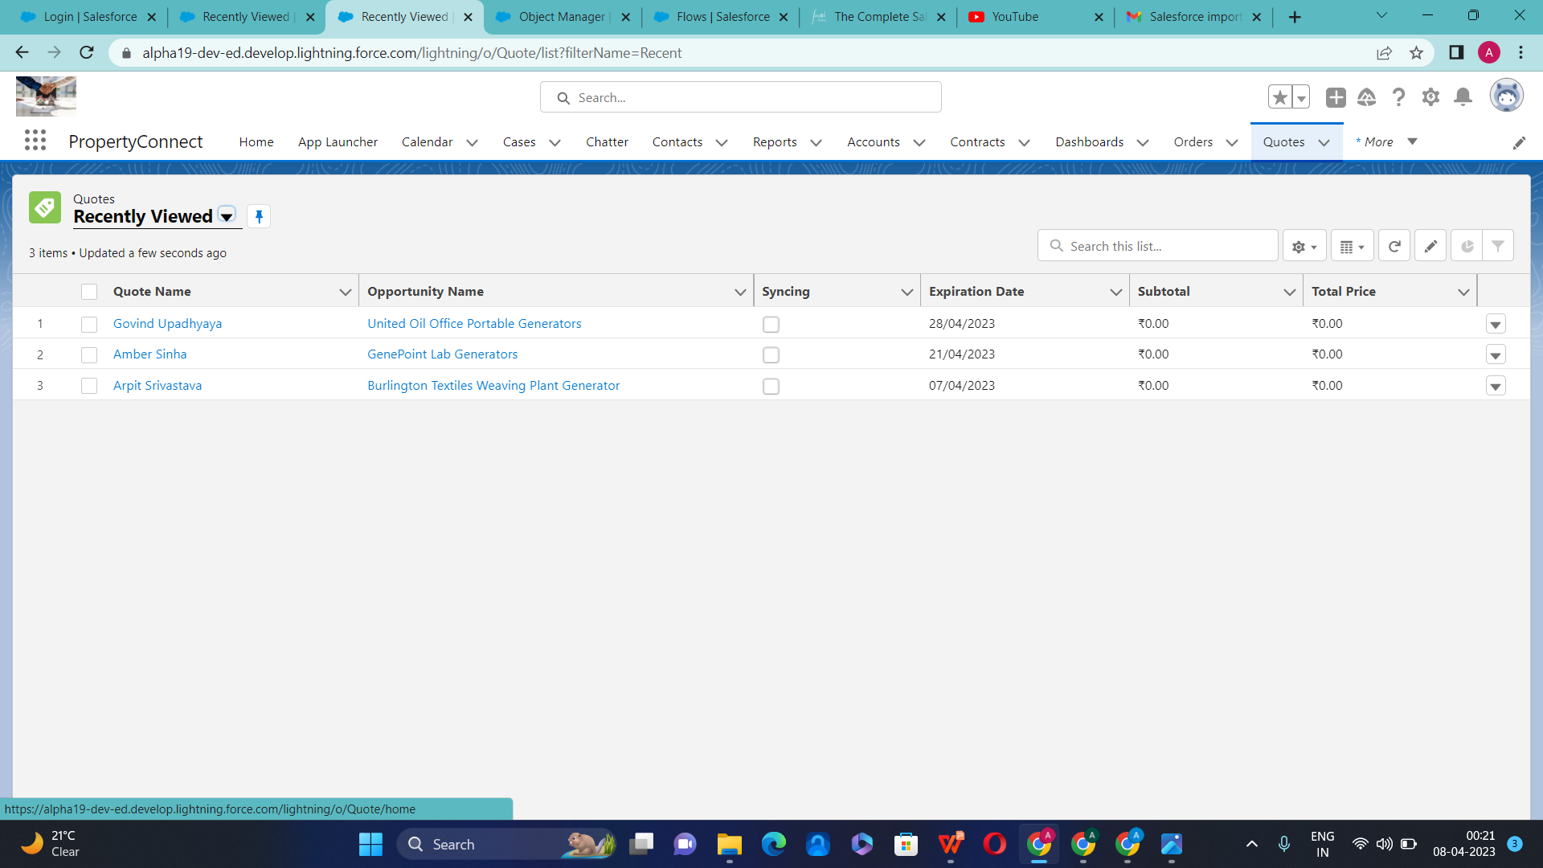
Creation of Quote

Slide 47
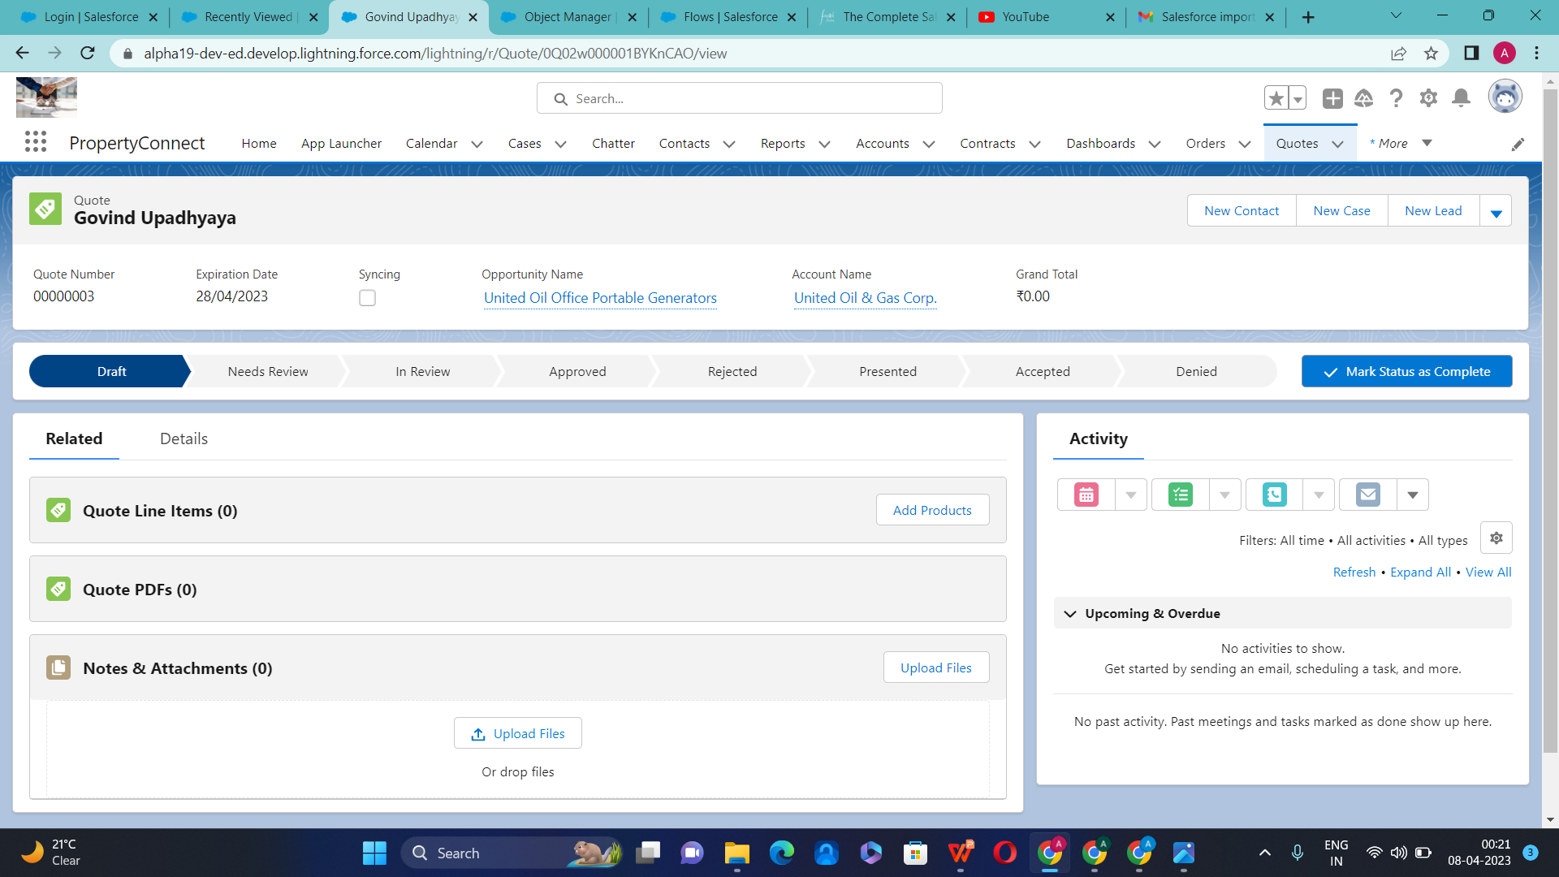
Quote

Slide 48
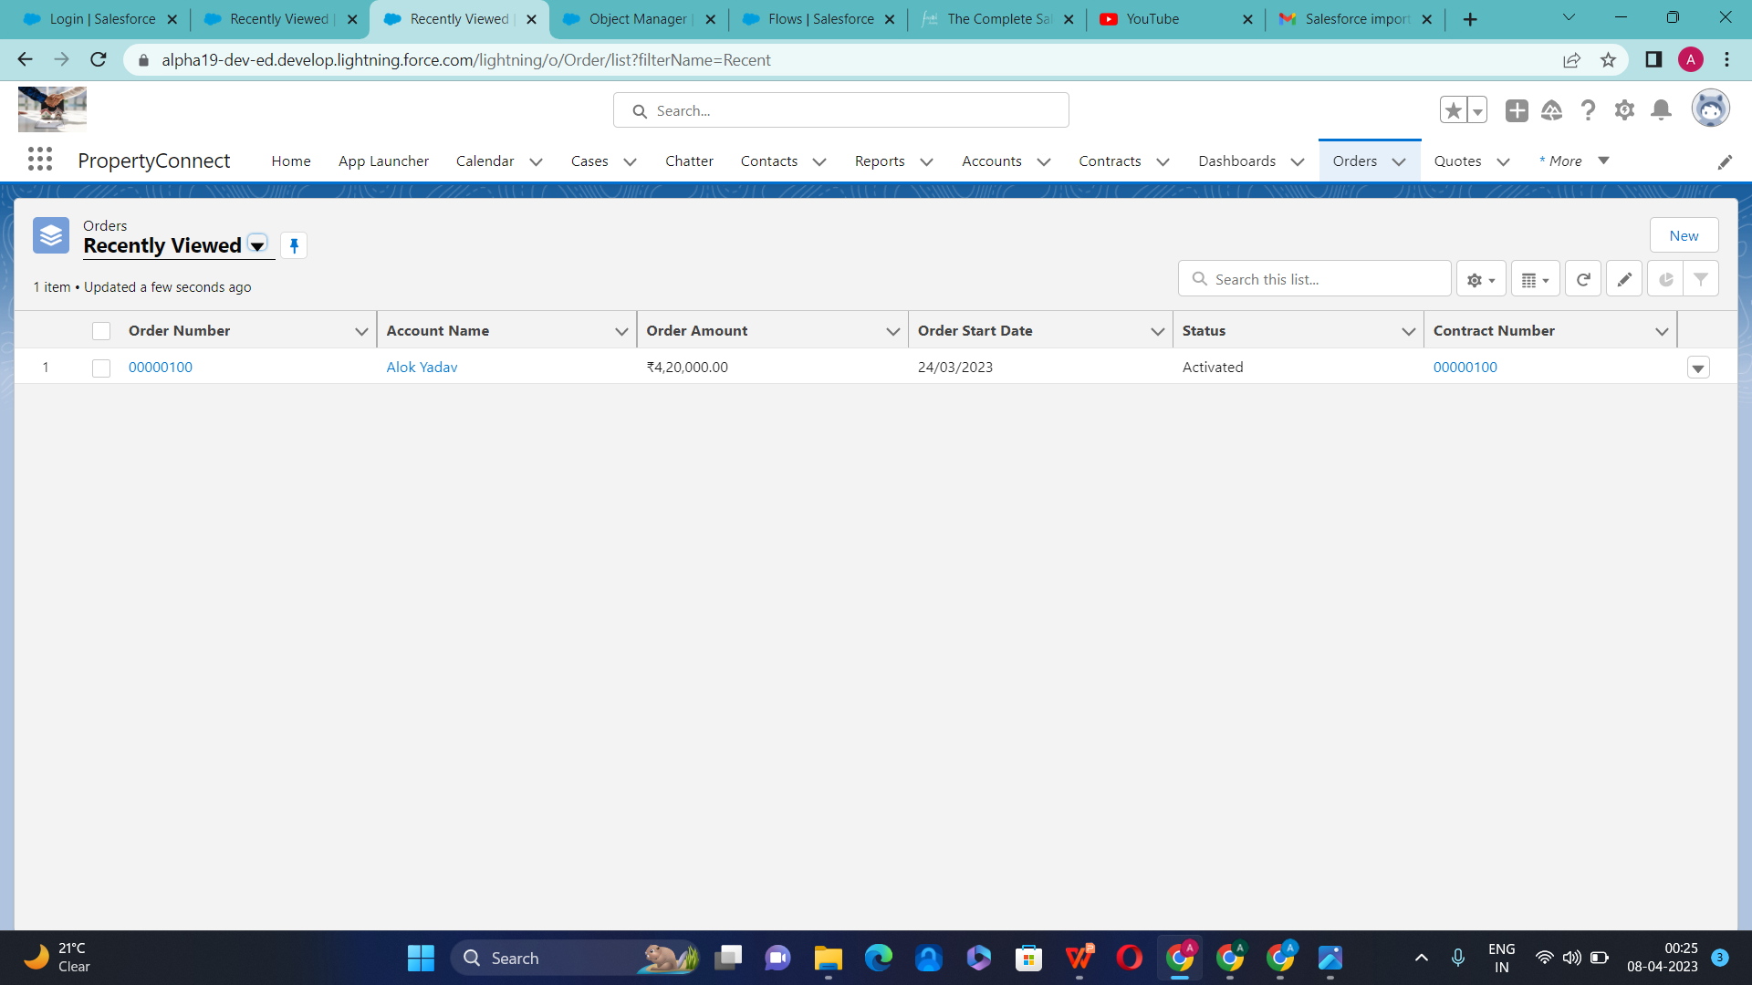
Creation of Orders

Slide 49
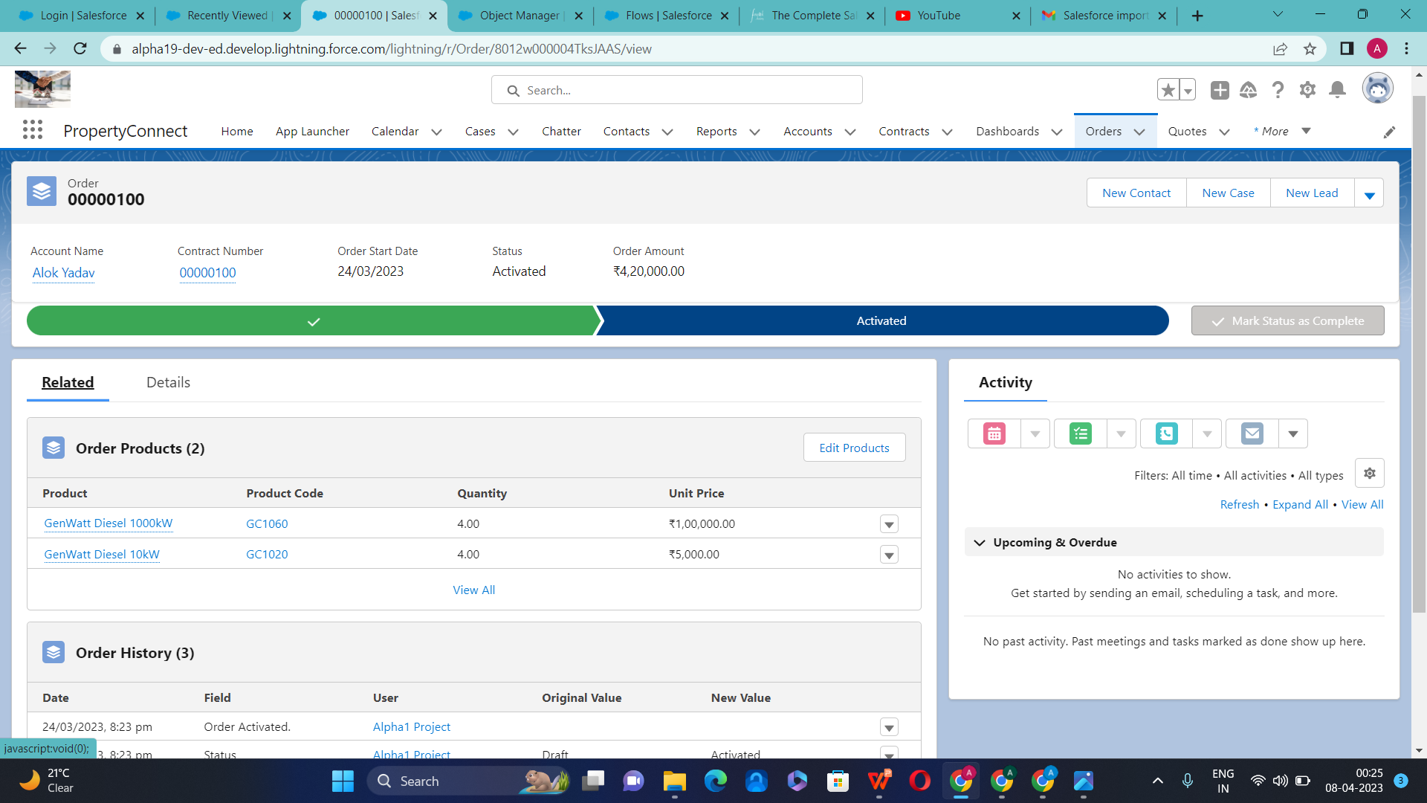
Order

Slide 50
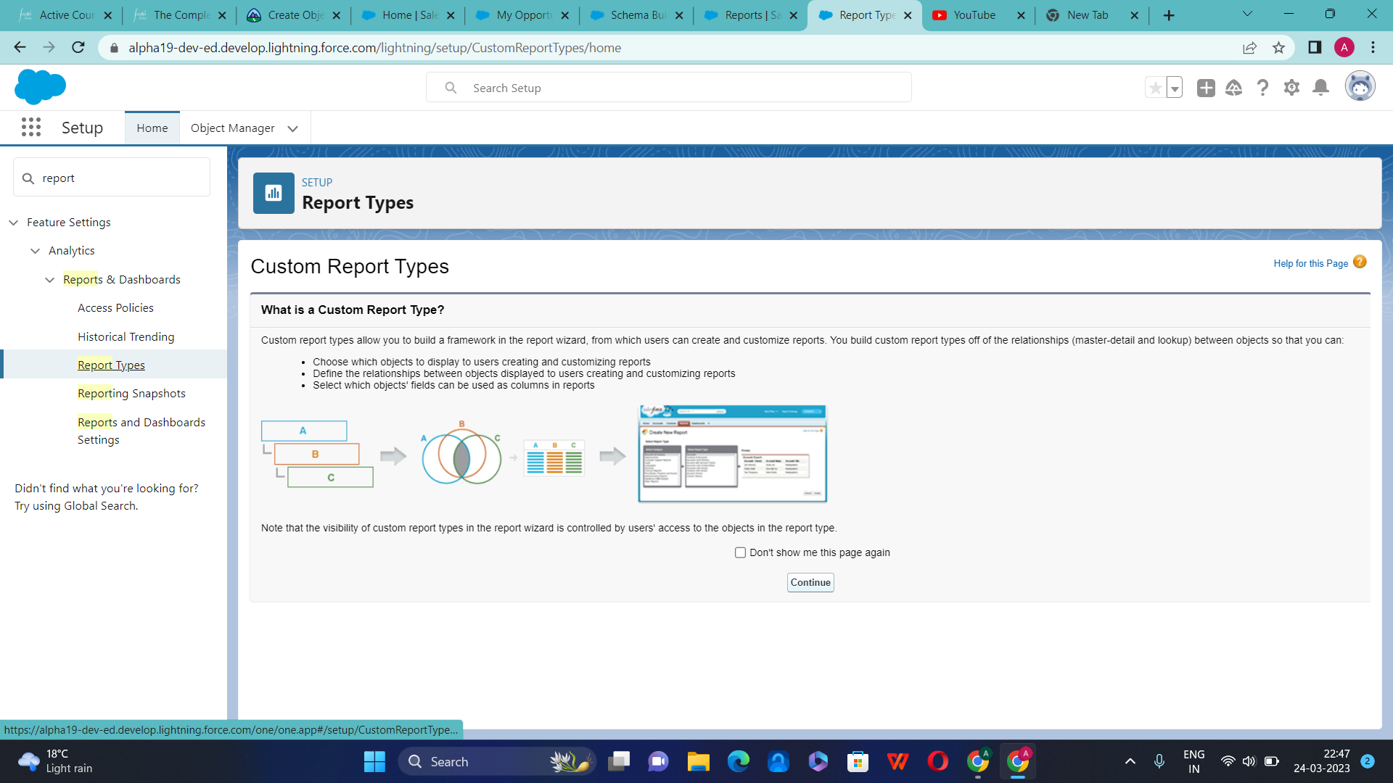
Custom Report Types

Slide 51
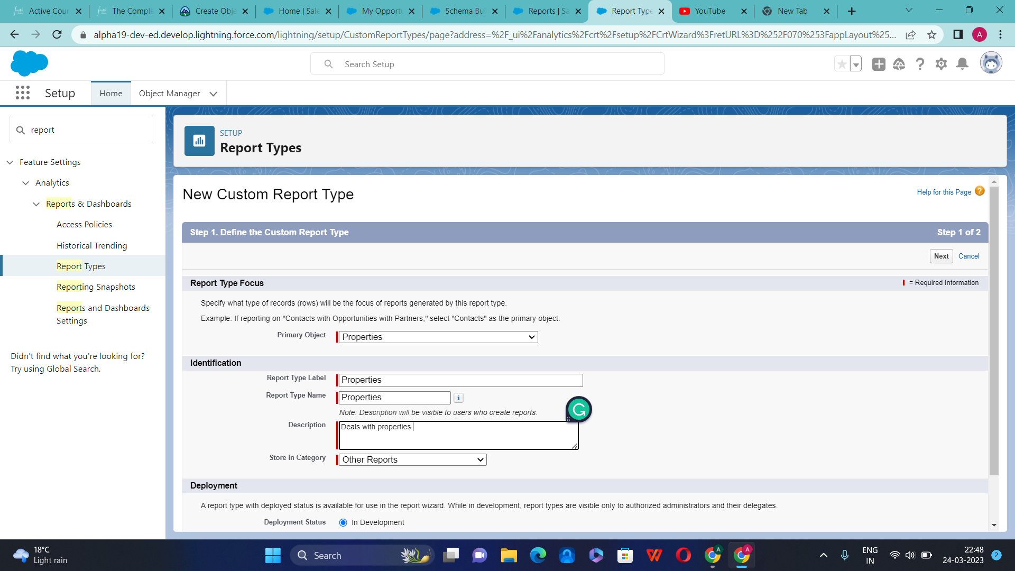

Slide 52
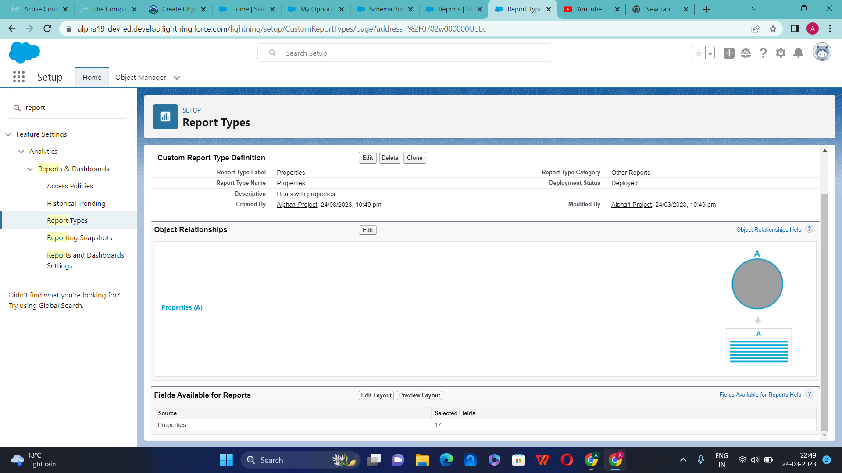

Slide 53

Creation of Report

Slide 54


Slide 55


Slide 56


Slide 57


Slide 58


Slide 59


Slide 60

Creation of New Dashboard

Slide 61


Slide 62


Slide 63


Slide 64

Chatter Settings

Slide 65


Slide 66


Slide 67


Slide 68

Creation of New Group

Slide 69


Slide 70


Slide 71


Slide 72


Slide 73


Slide 74


Slide 75


Slide 76


Slide 77


Slide 78


Slide 79

Set up Role Hierarchy

Slide 80


Slide 81


Slide 82


Slide 83


Slide 84


Slide 85
Thank You So Much !

